Slide 1


Slide 2
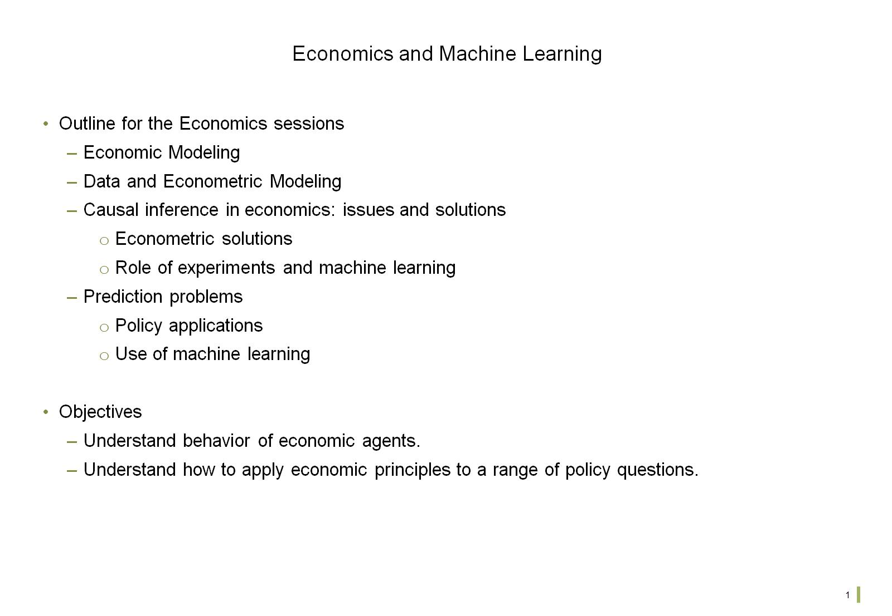
Economics and Machine Learning

Slide 3
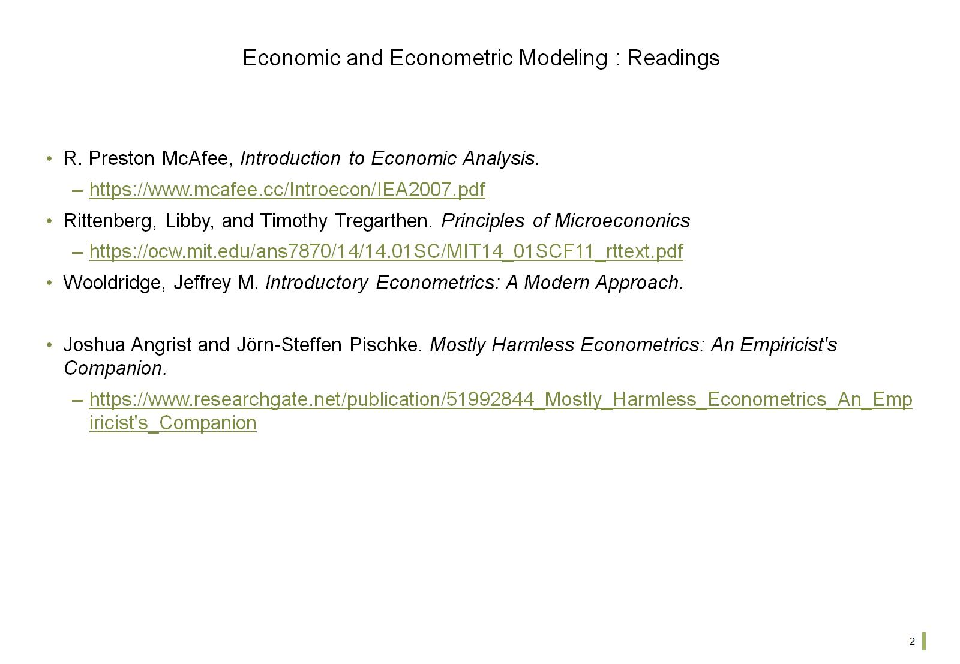
Economic and Econometric Modeling : Readings

Slide 4
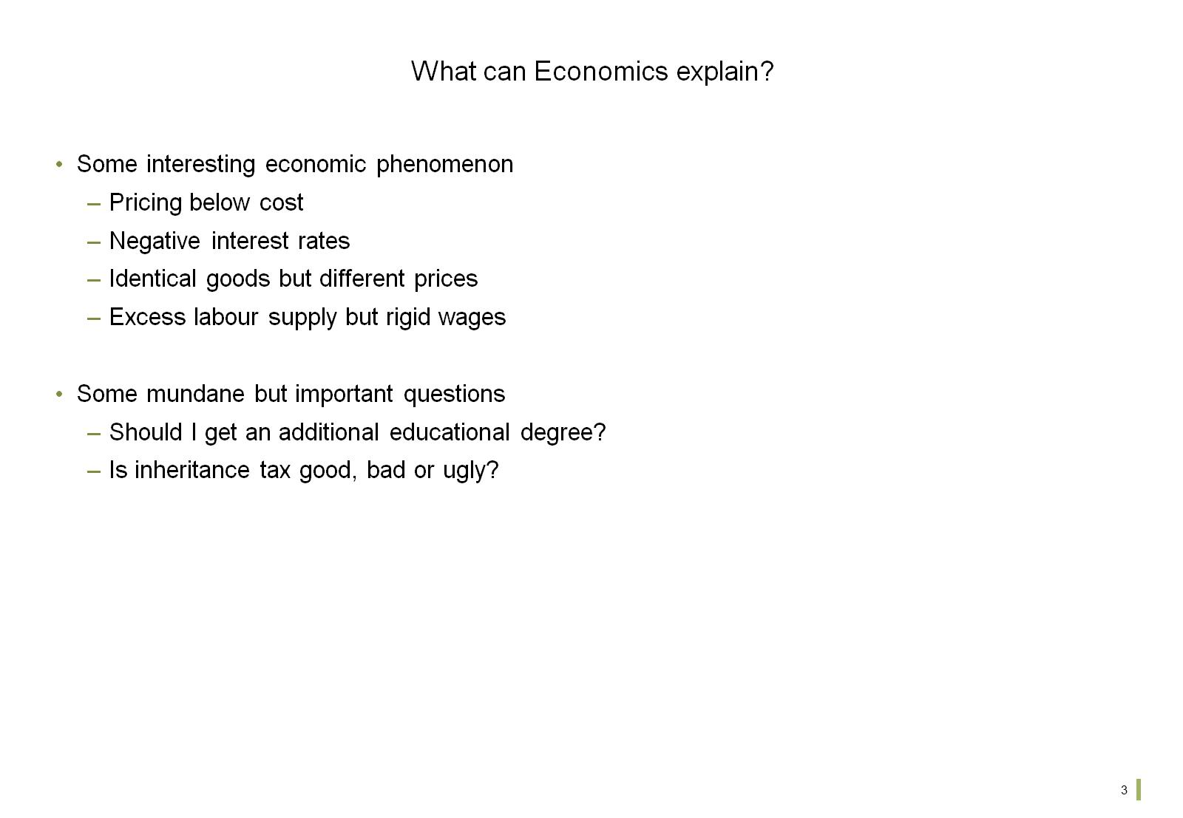
What can Economics explain?

Slide 5
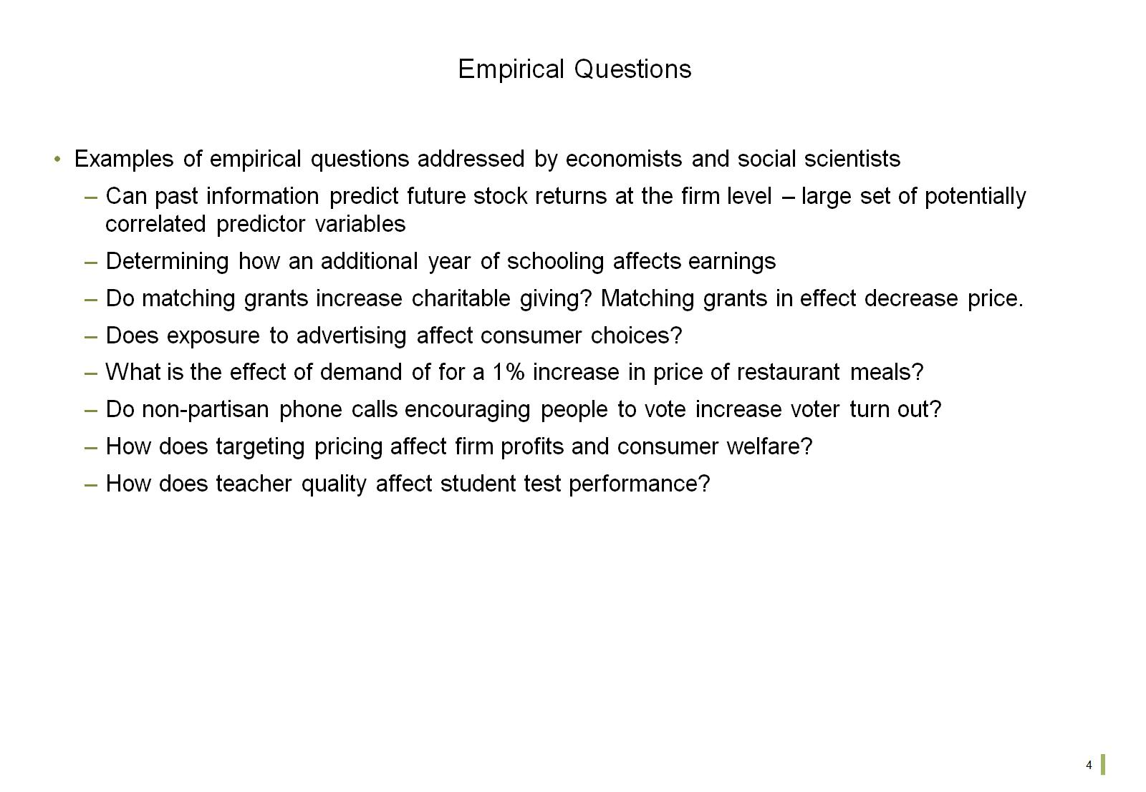
Empirical Questions

Slide 6
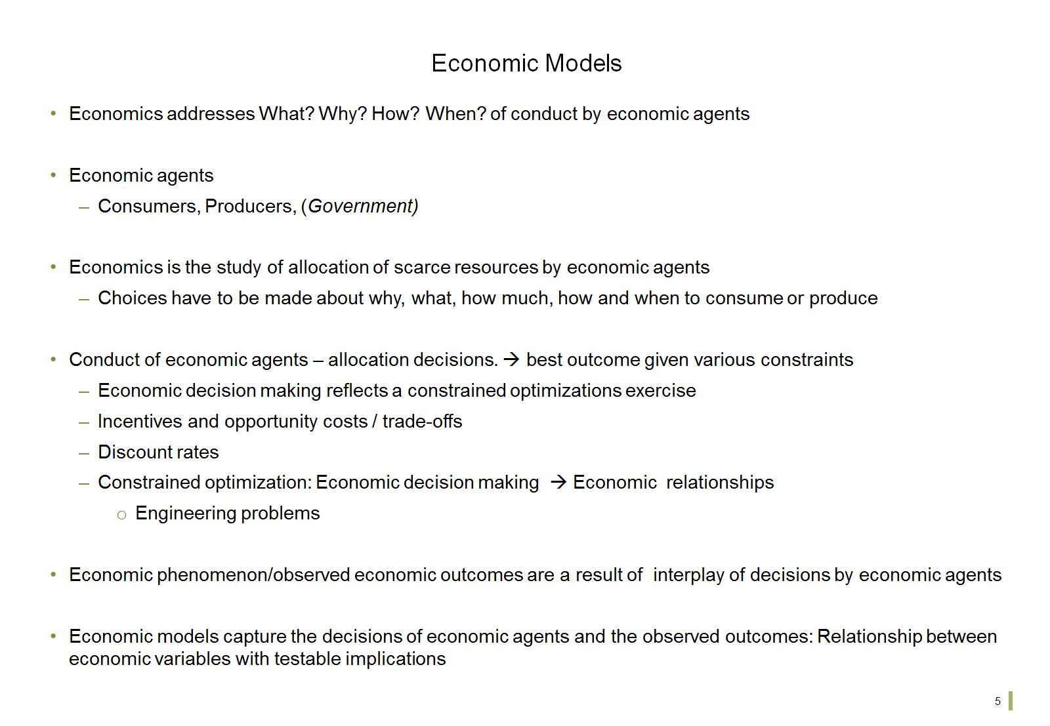
Economic Models

Slide 7
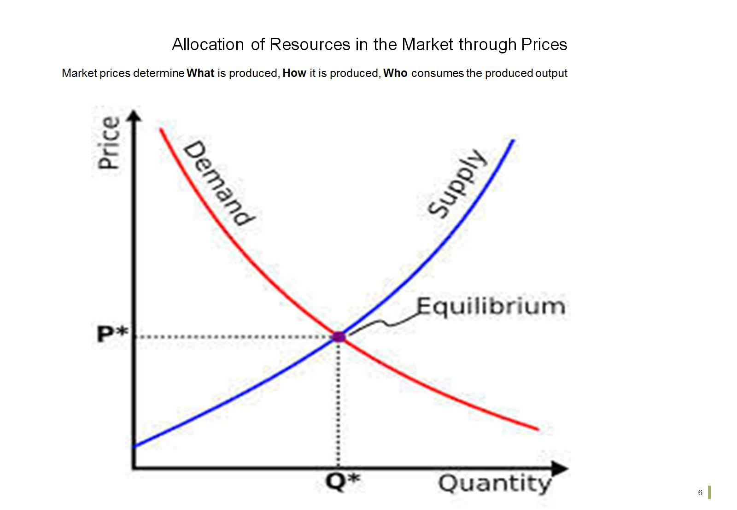
Allocation of Resources in the Market through Prices

Slide 8
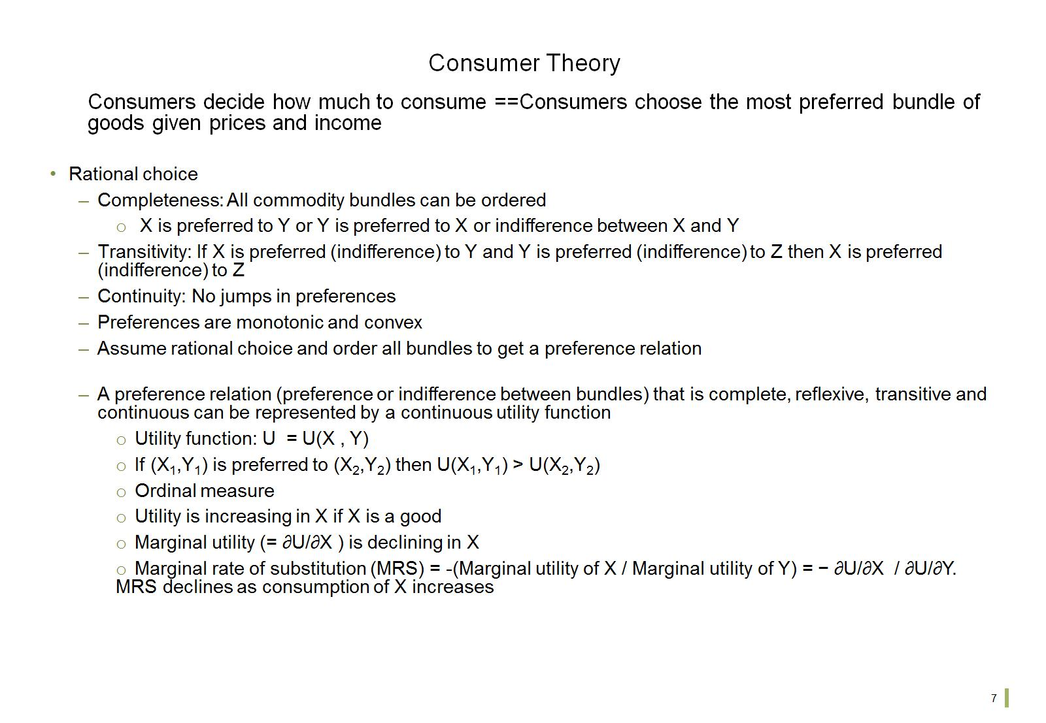
Consumer Theory

Slide 9
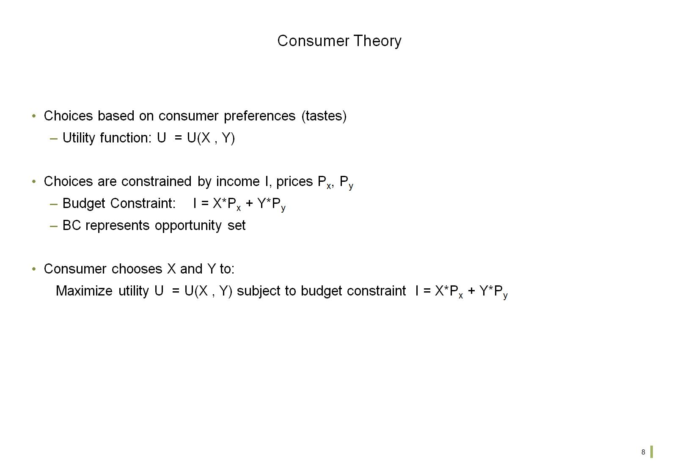
Consumer Theory

Slide 10
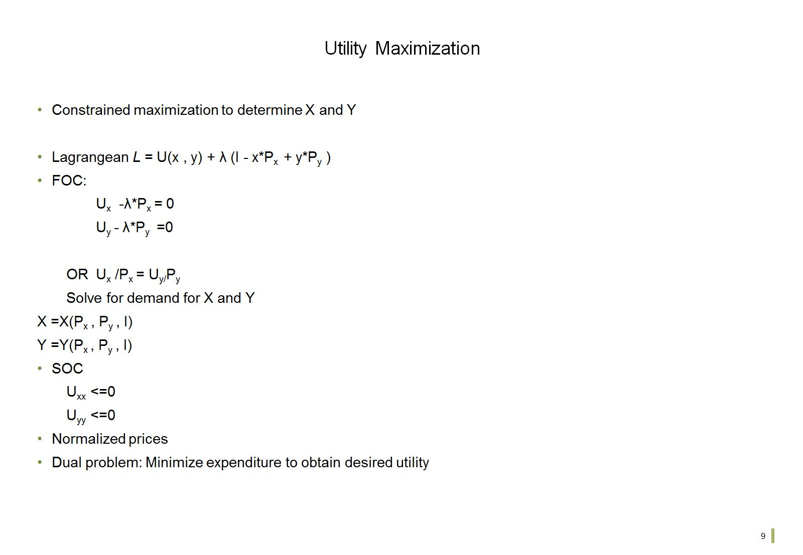
Utility Maximization

Slide 11
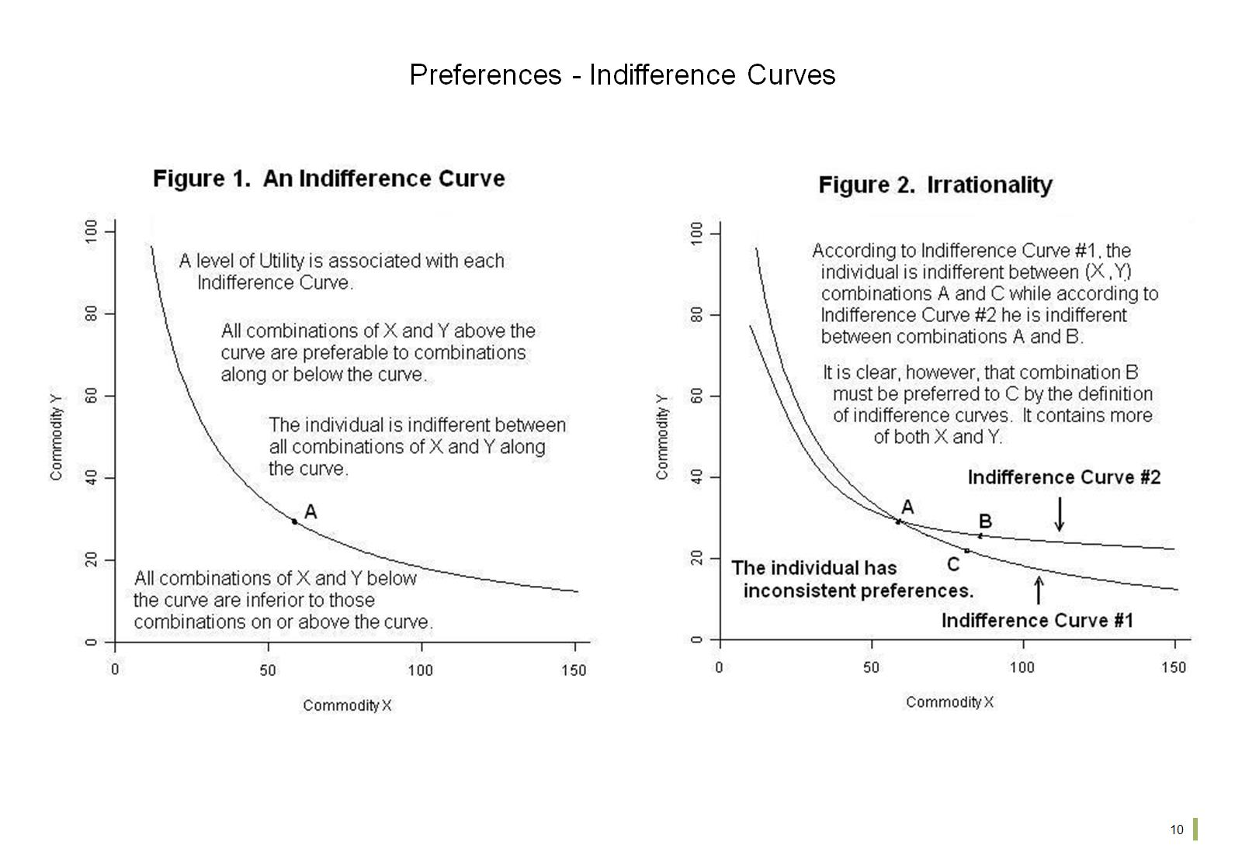
Preferences - Indifference Curves

Slide 12
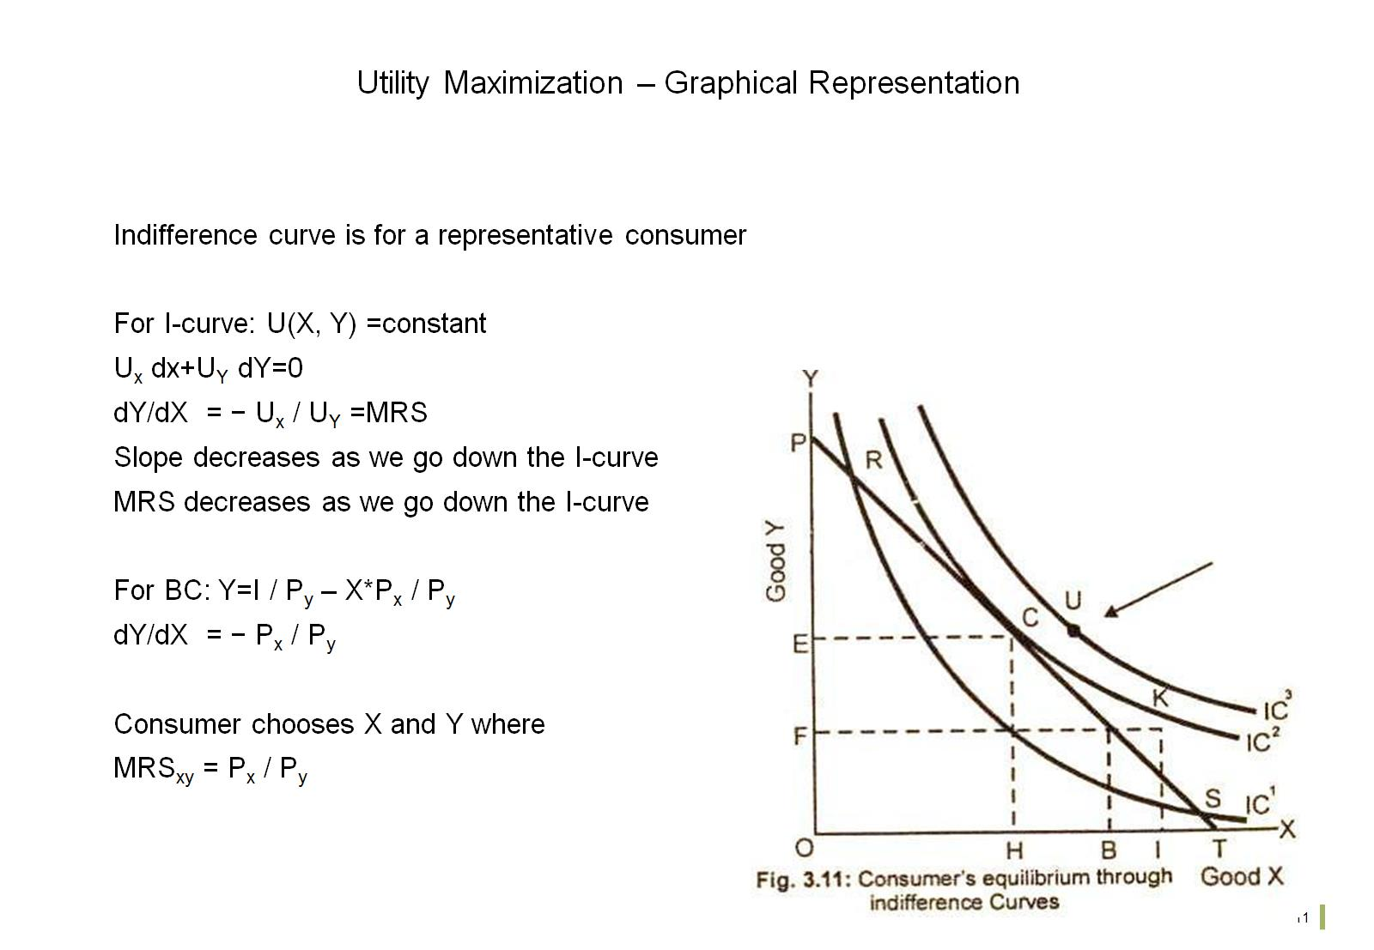
Utility Maximization – Graphical Representation

Slide 13
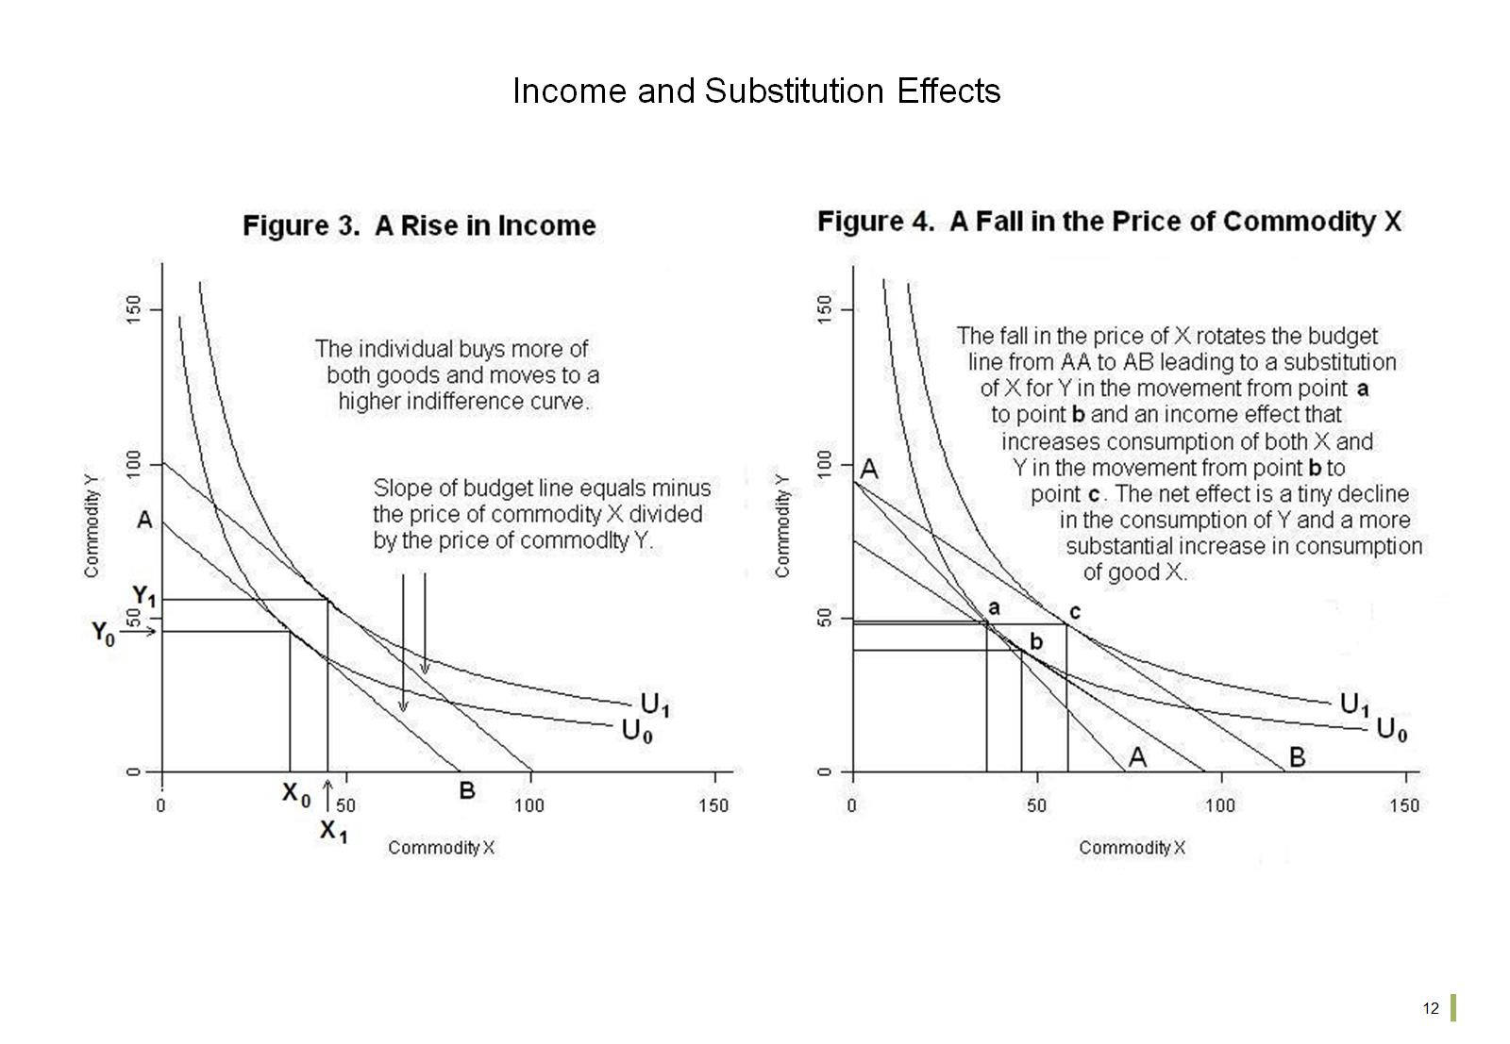
Income and Substitution Effects

Slide 14
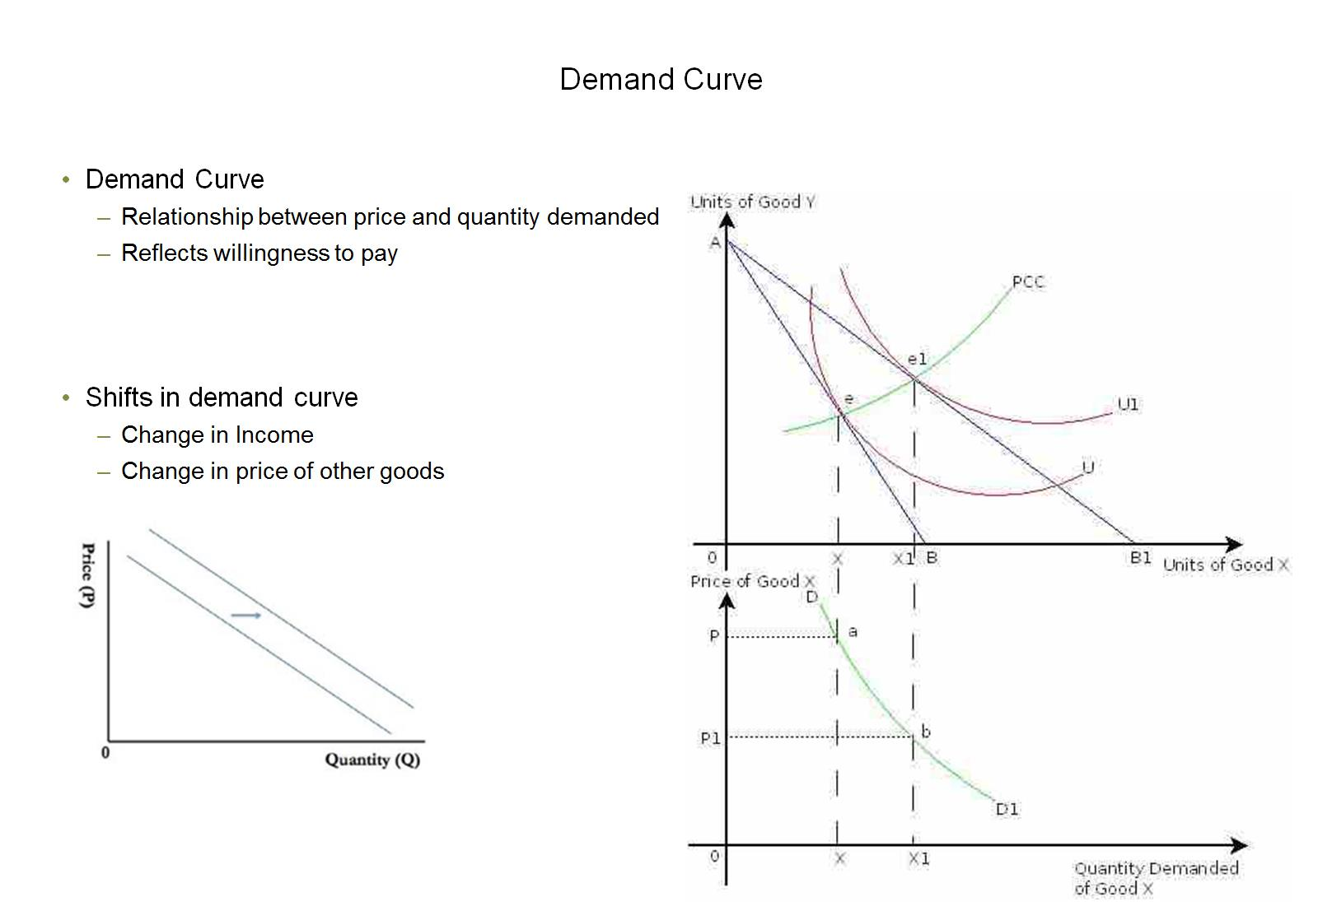
Demand Curve

Slide 15
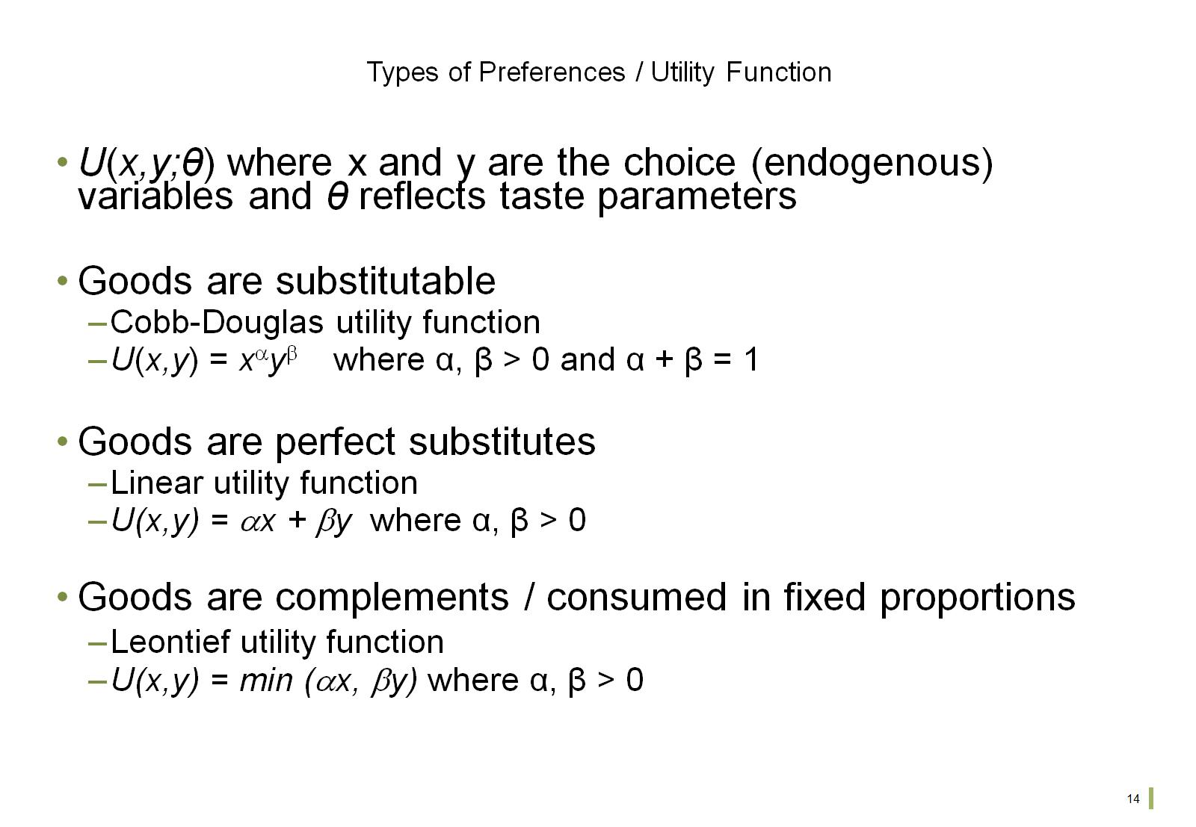
Types of Preferences / Utility Function

Slide 16
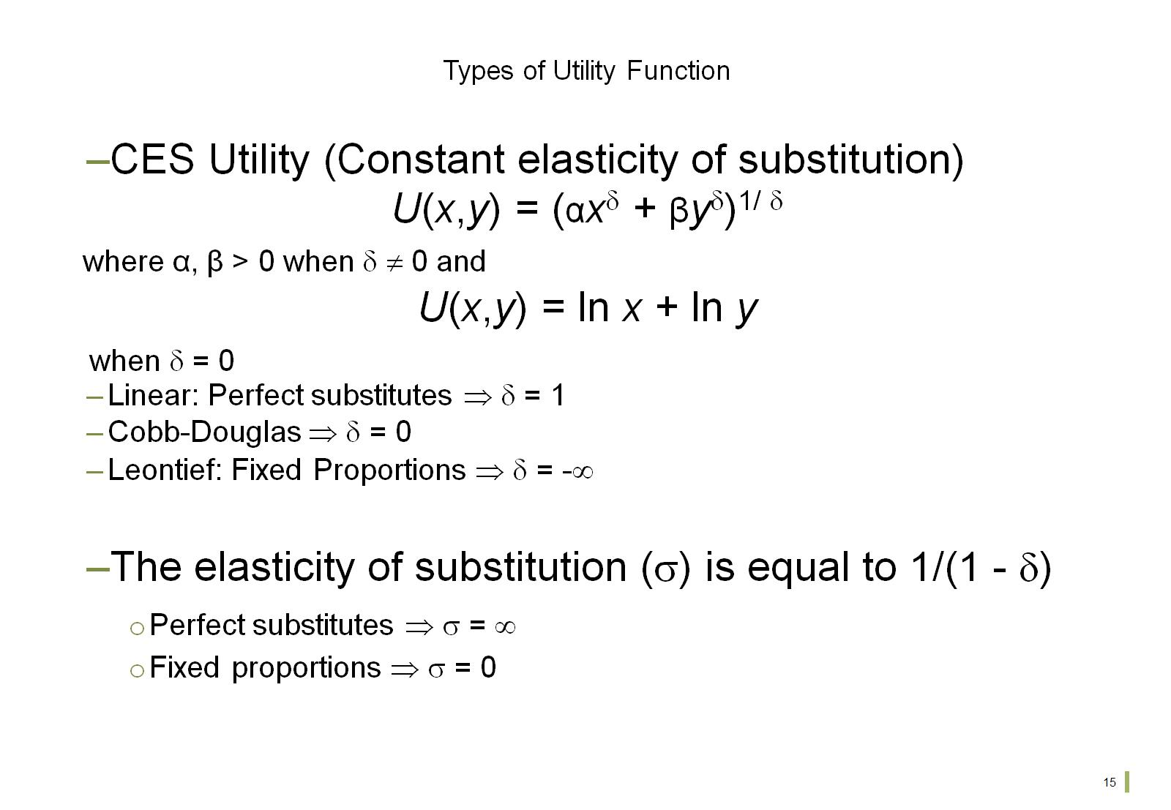
Types of Utility Function

Slide 17
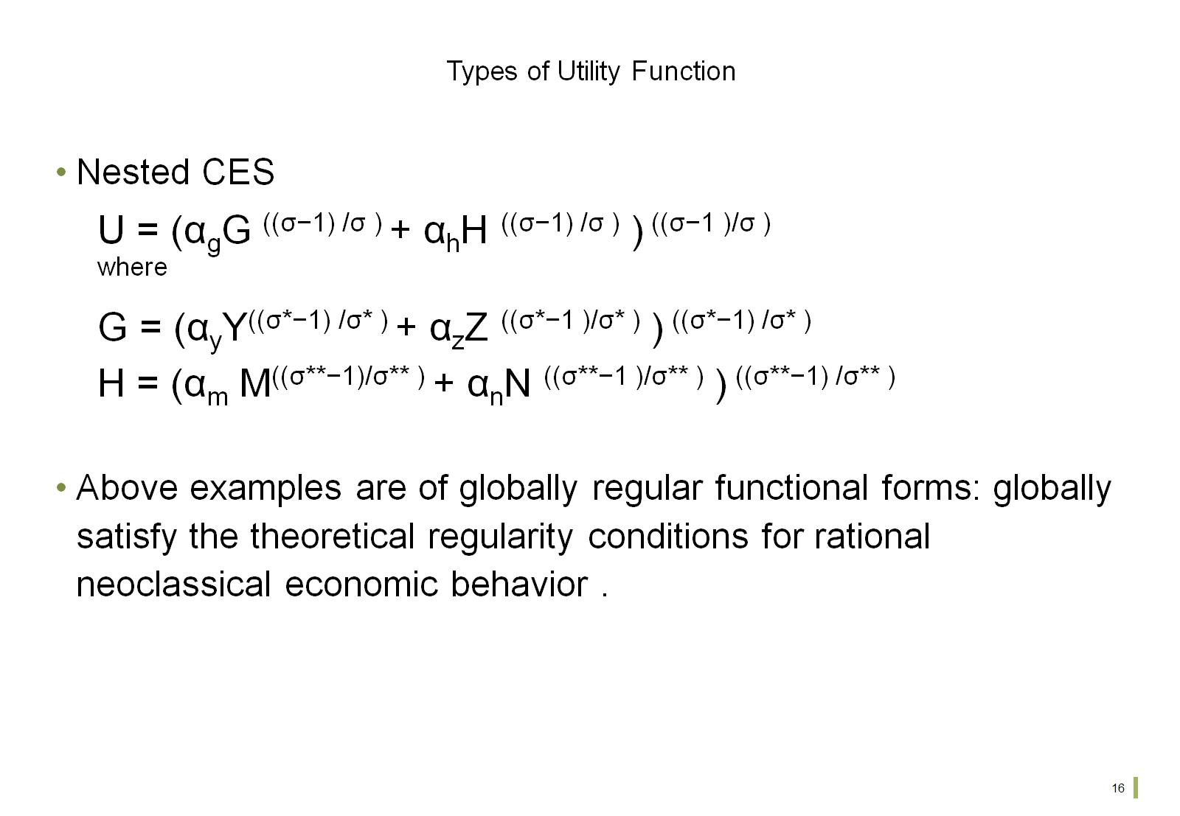
Types of Utility Function

Slide 18
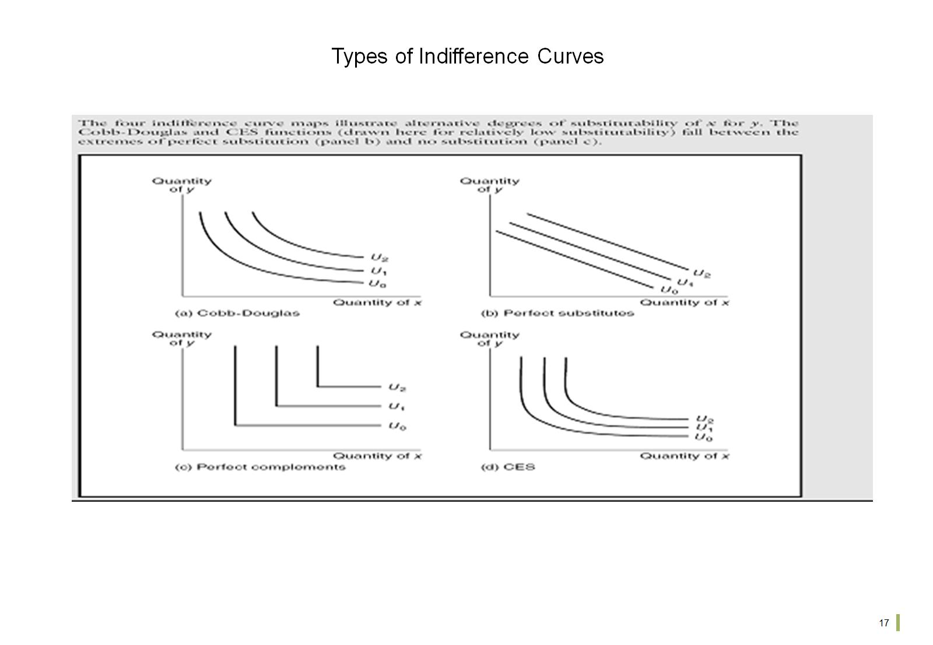
Types of Indifference Curves

Slide 19
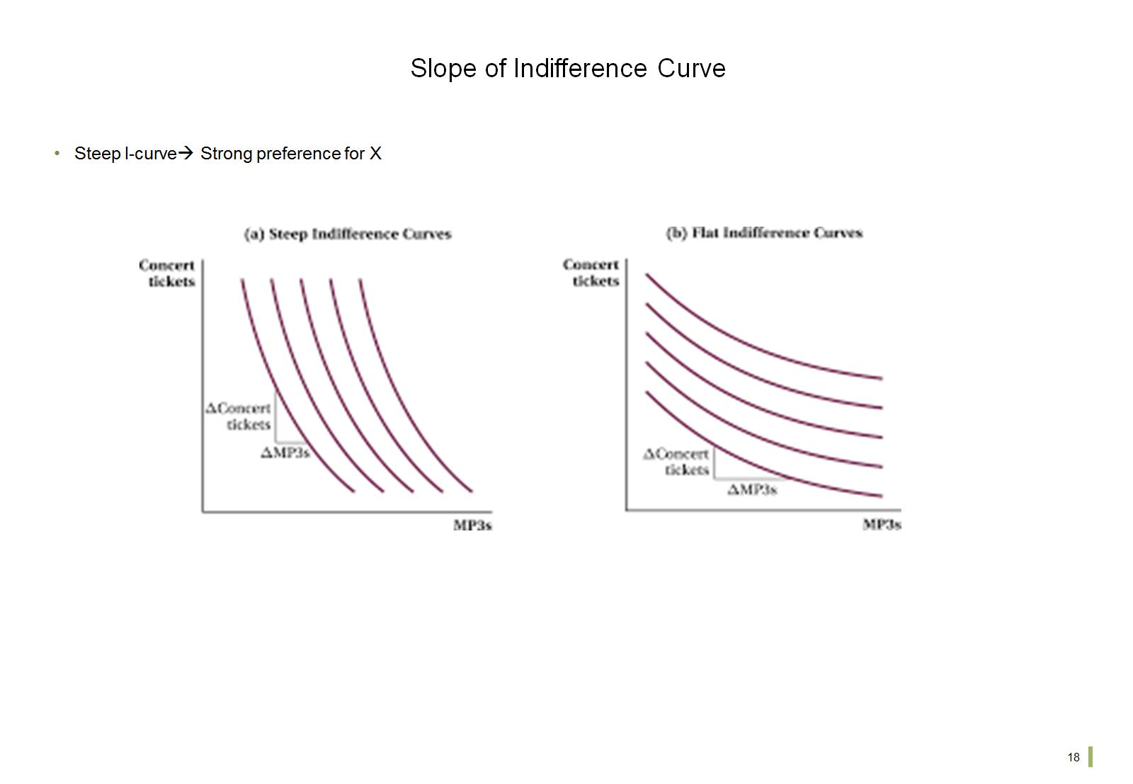
Slope of Indifference Curve

Slide 20
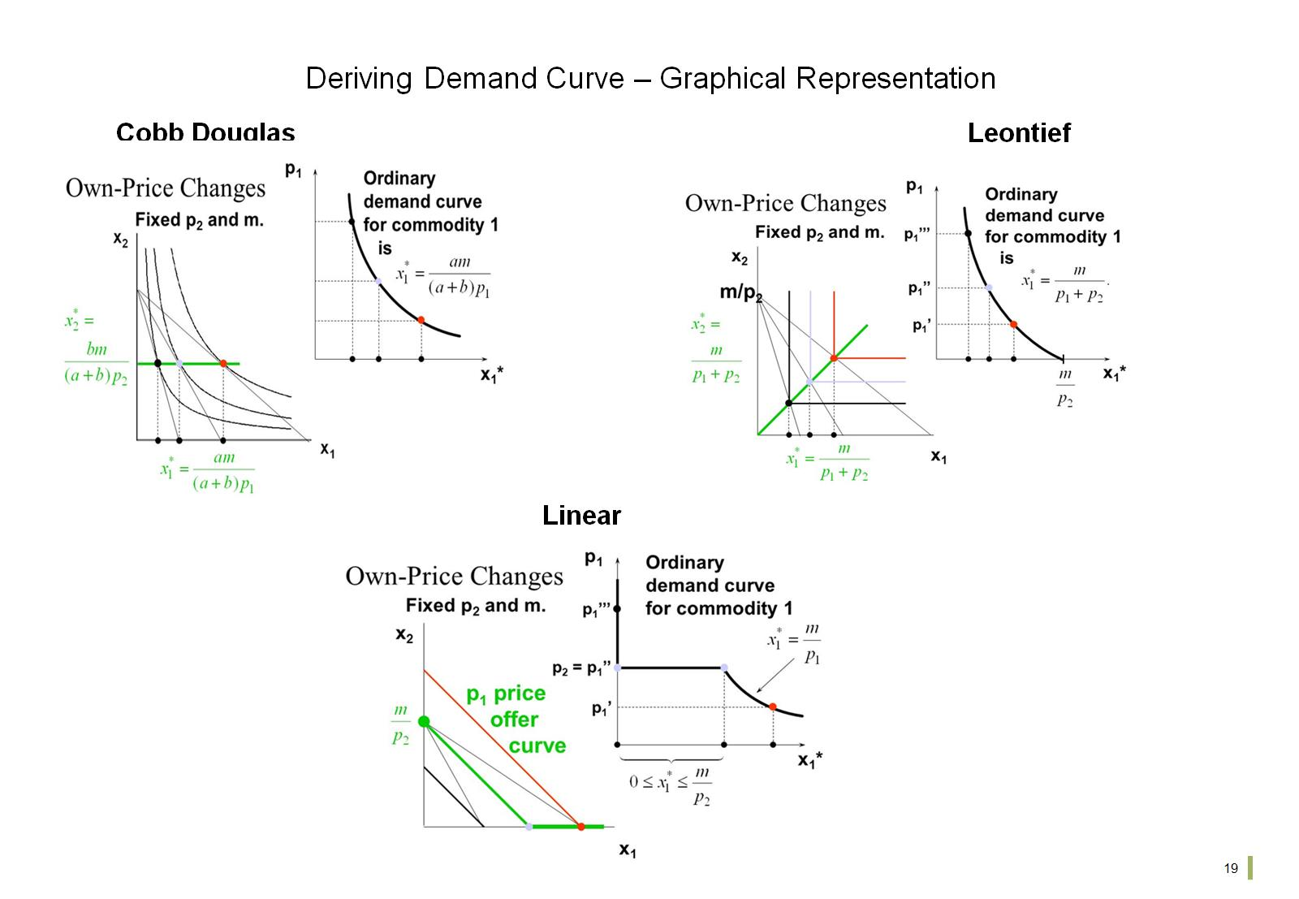
Deriving Demand Curve – Graphical Representation

Slide 21
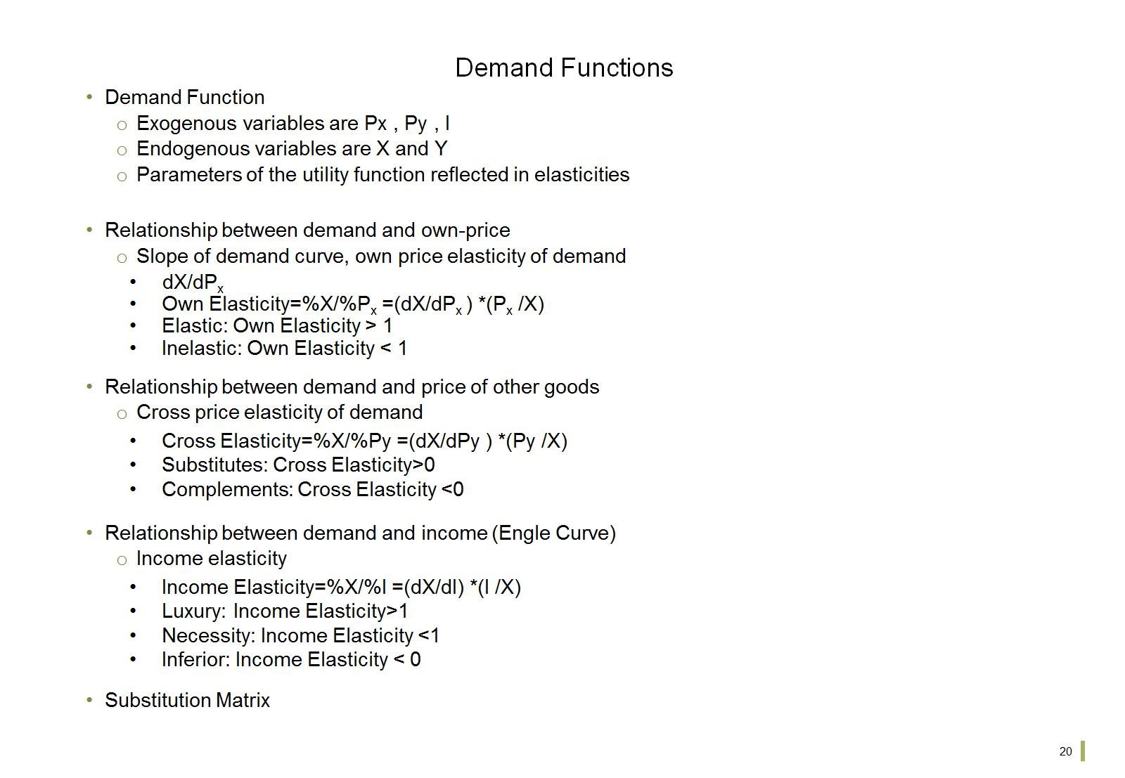
Demand Functions

Slide 22
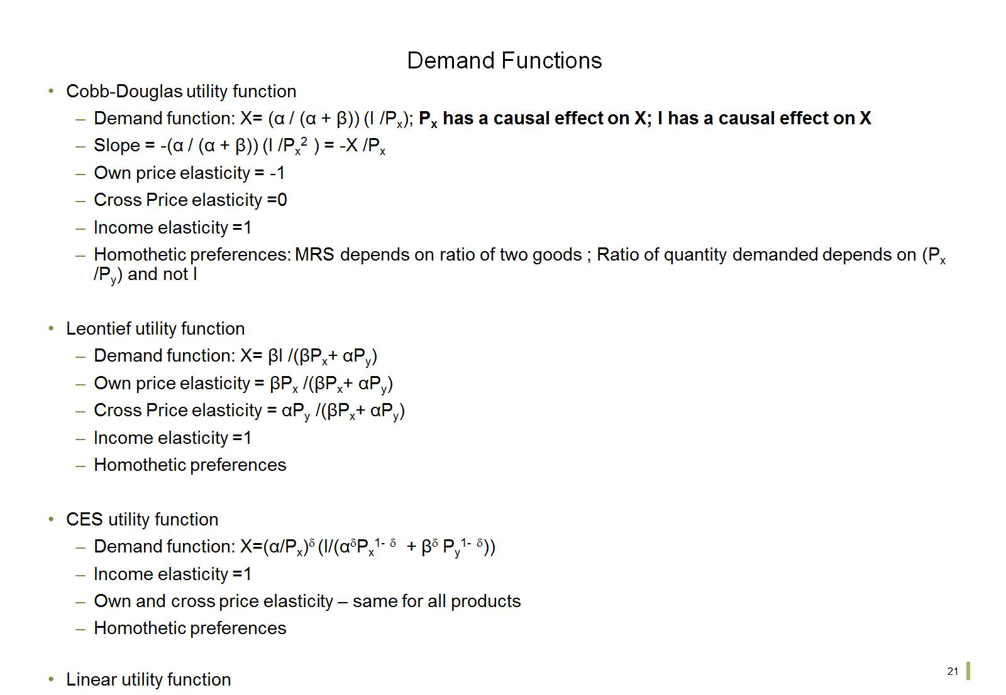
Demand Functions

Slide 23
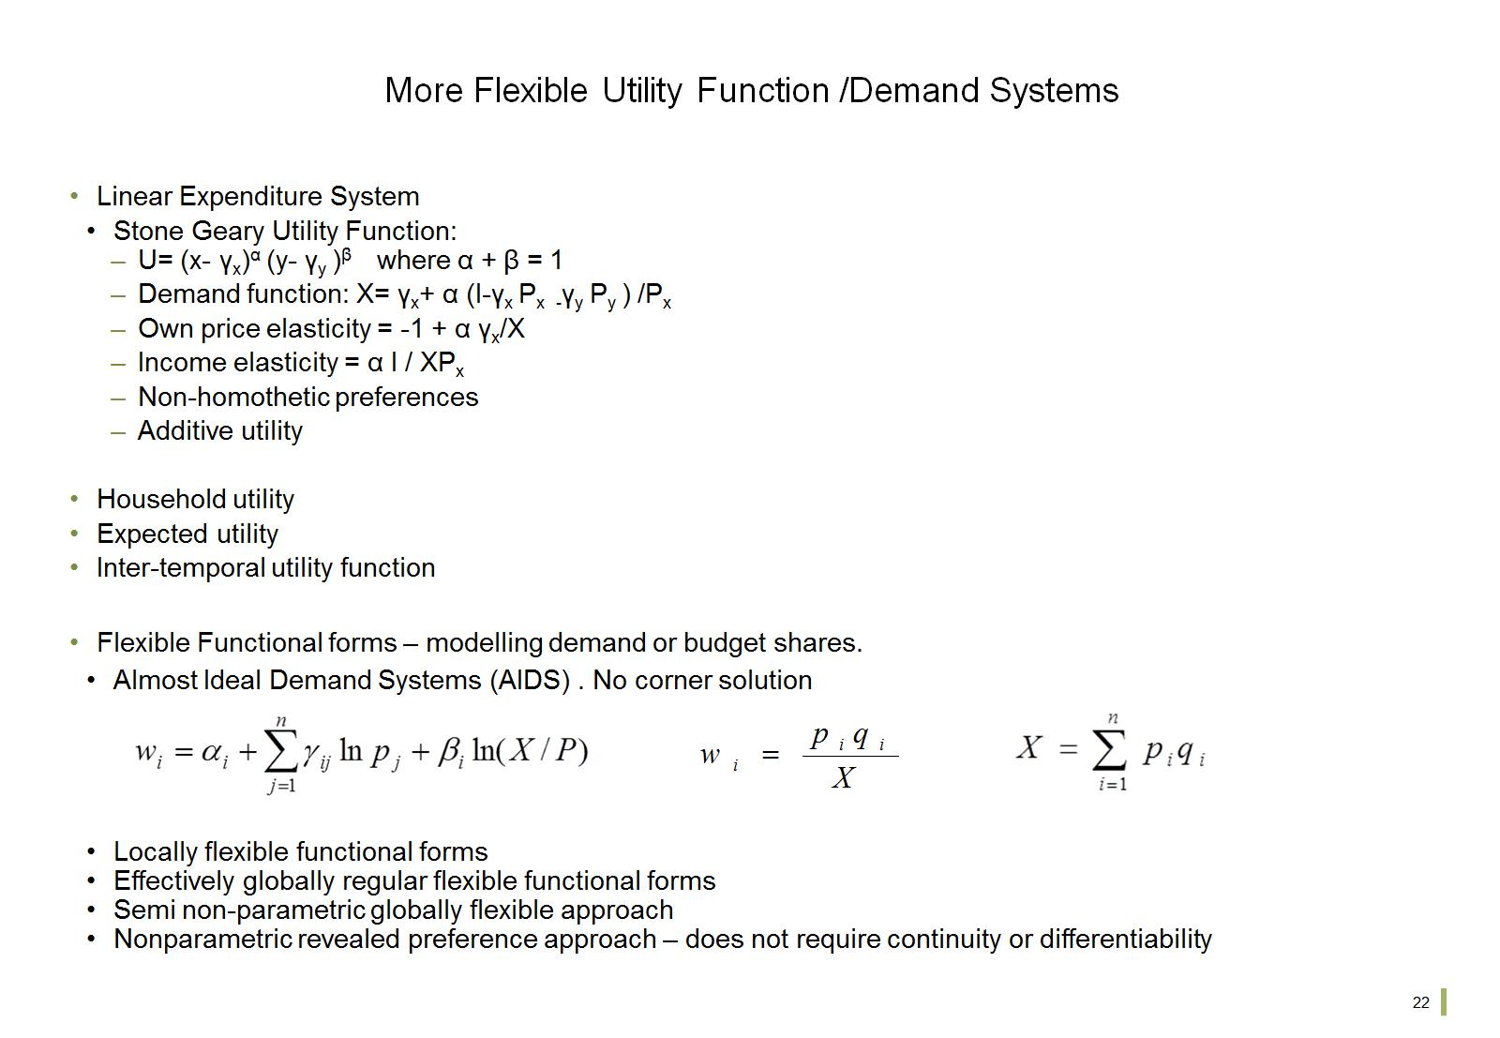
More Flexible Utility Function /Demand Systems

Slide 24
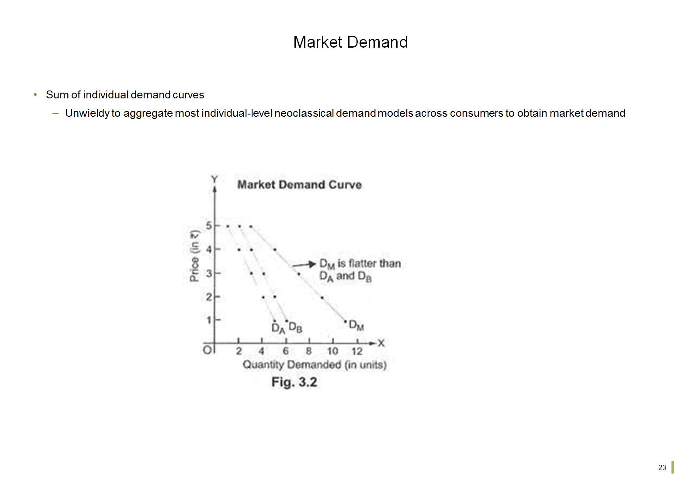
Market Demand

Slide 25
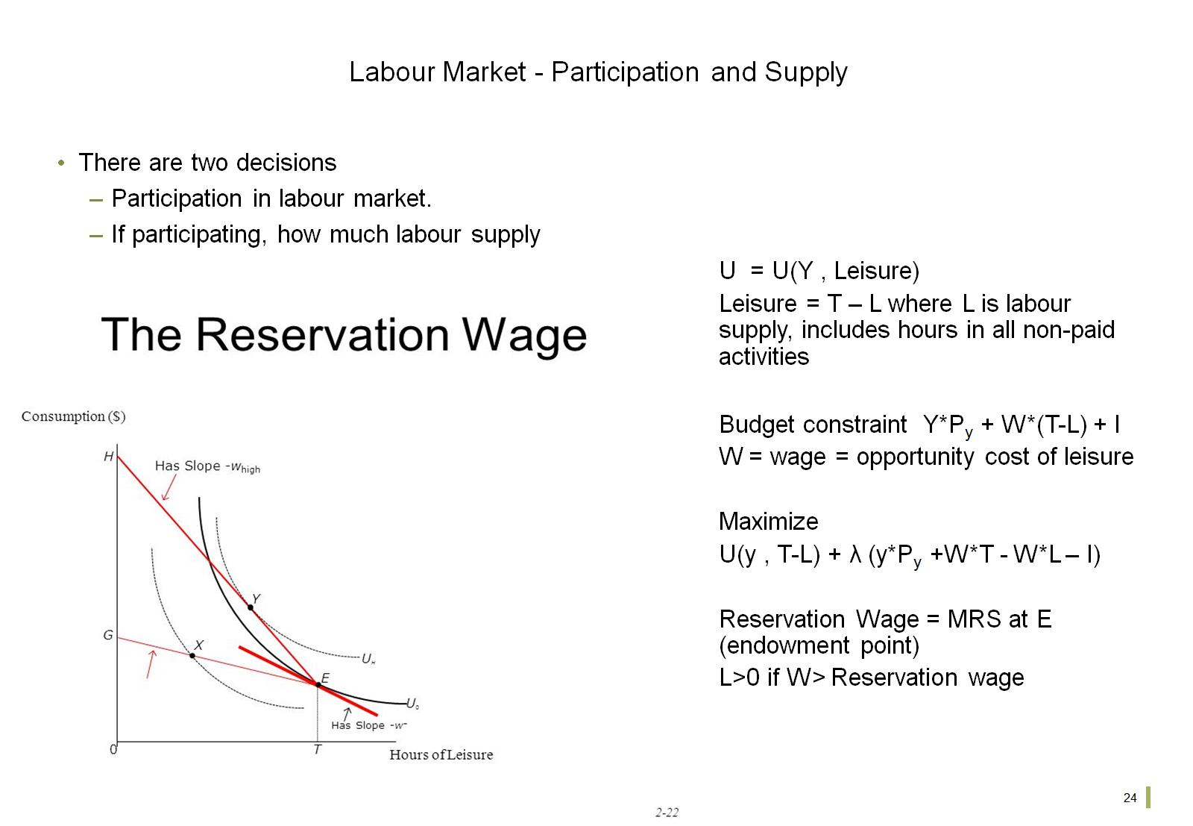
Labour Market - Participation and Supply

Slide 26
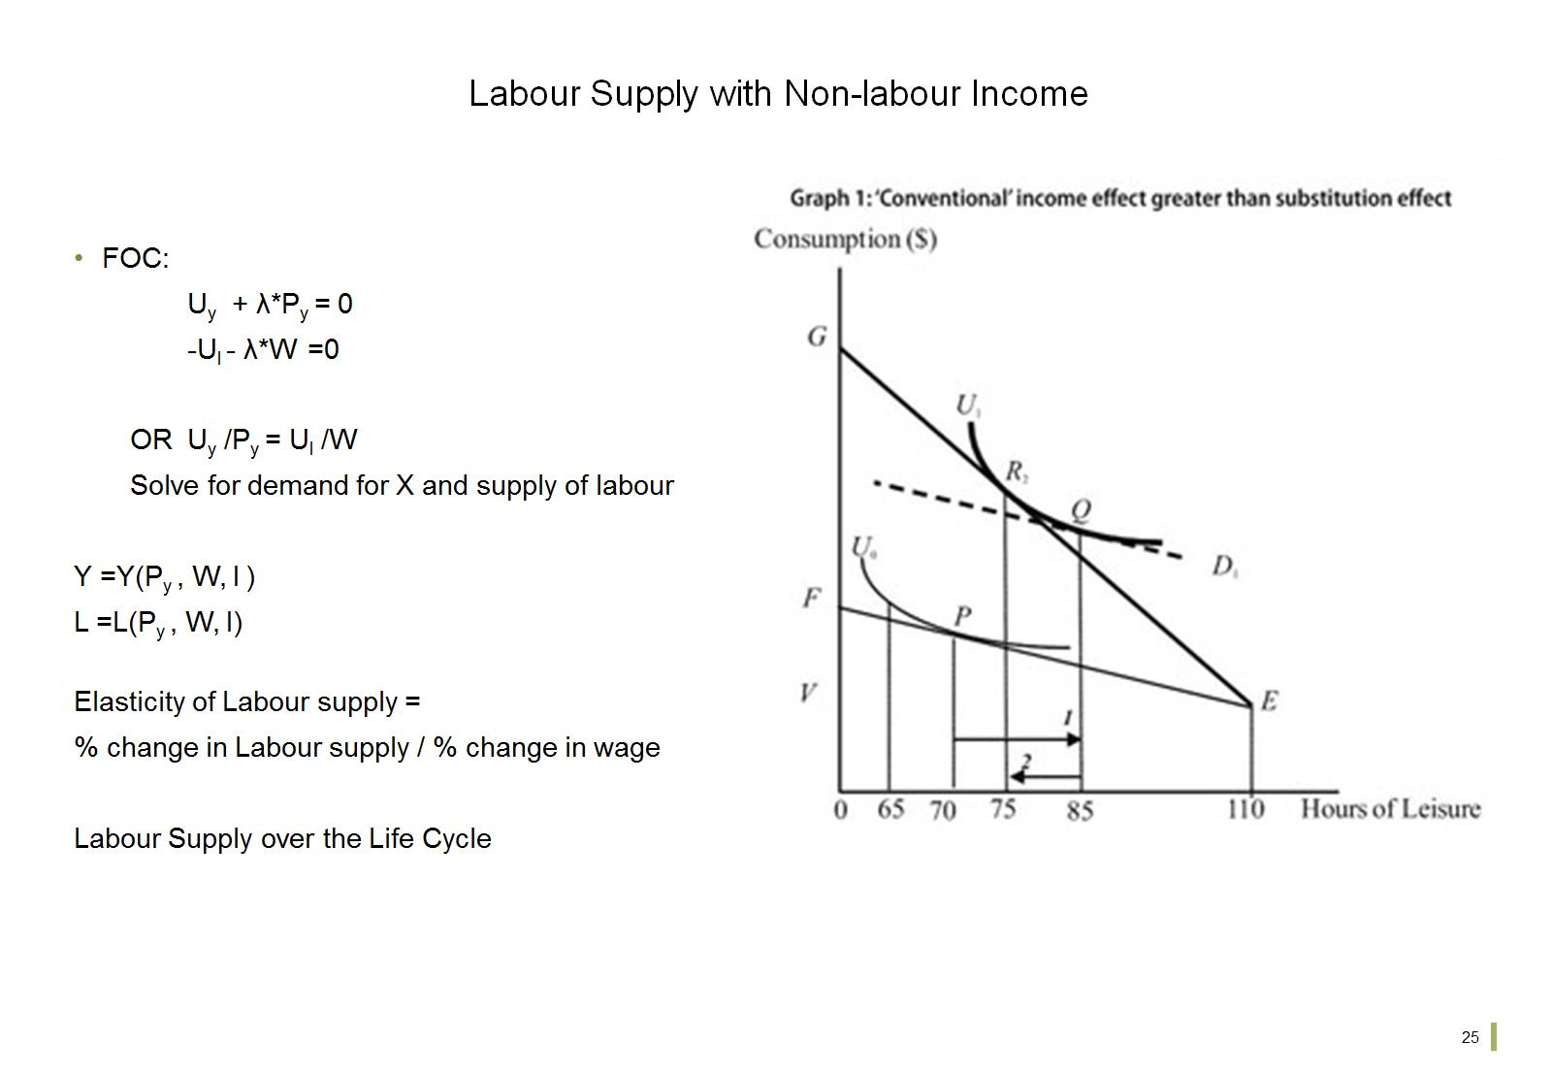
Labour Supply with Non-labour Income

Slide 27
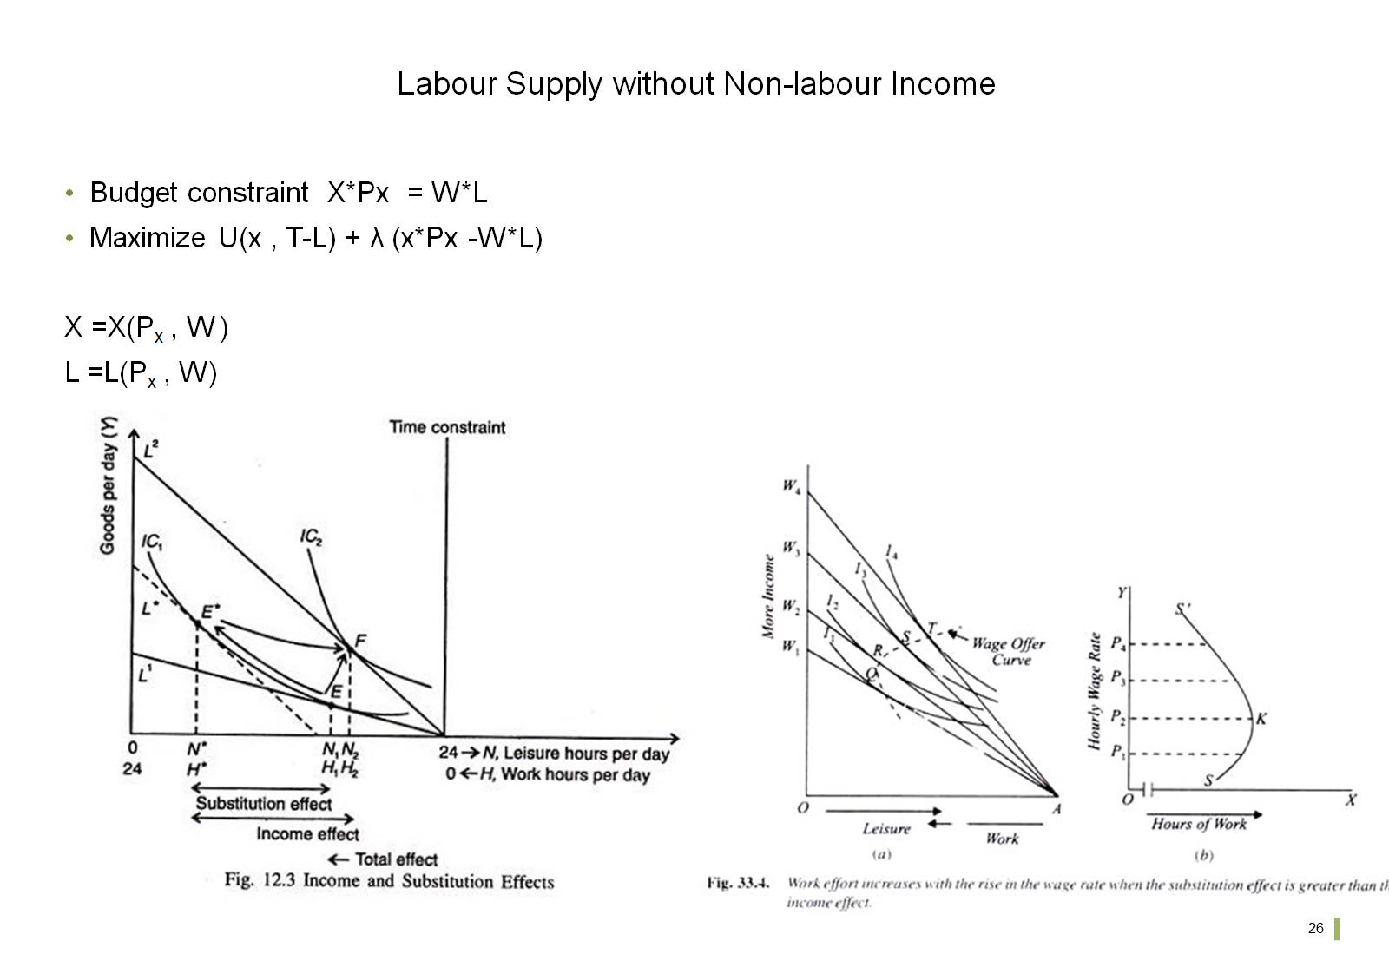
Labour Supply without Non-labour Income

Slide 28

Allocation of Resources in the Market through Prices

Slide 29
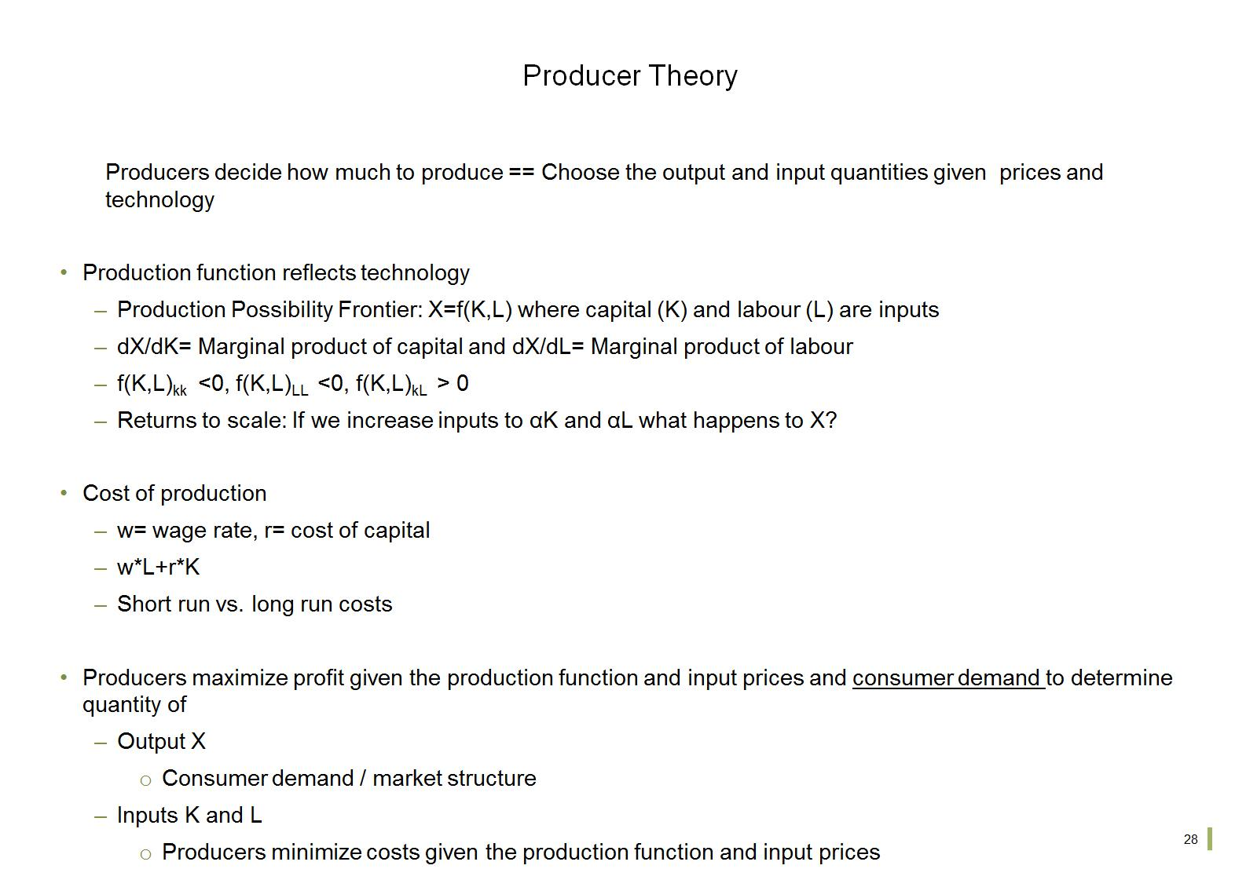
Producer Theory

Slide 30
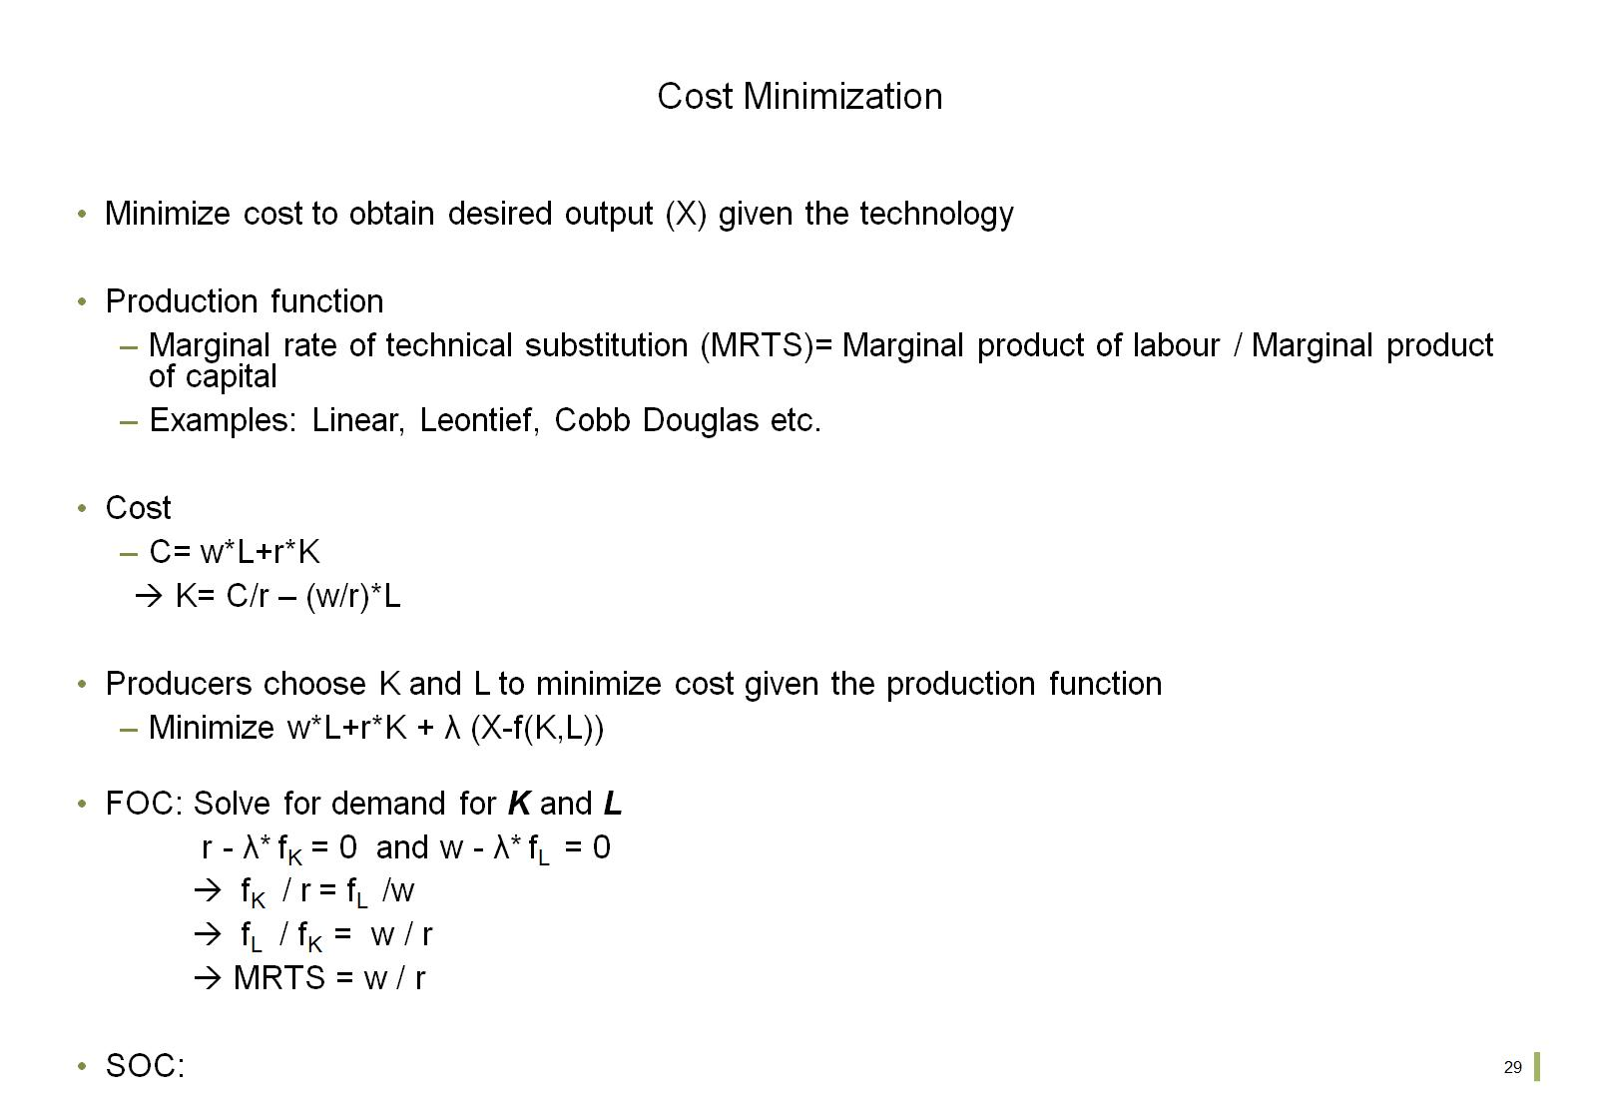
Cost Minimization

Slide 31
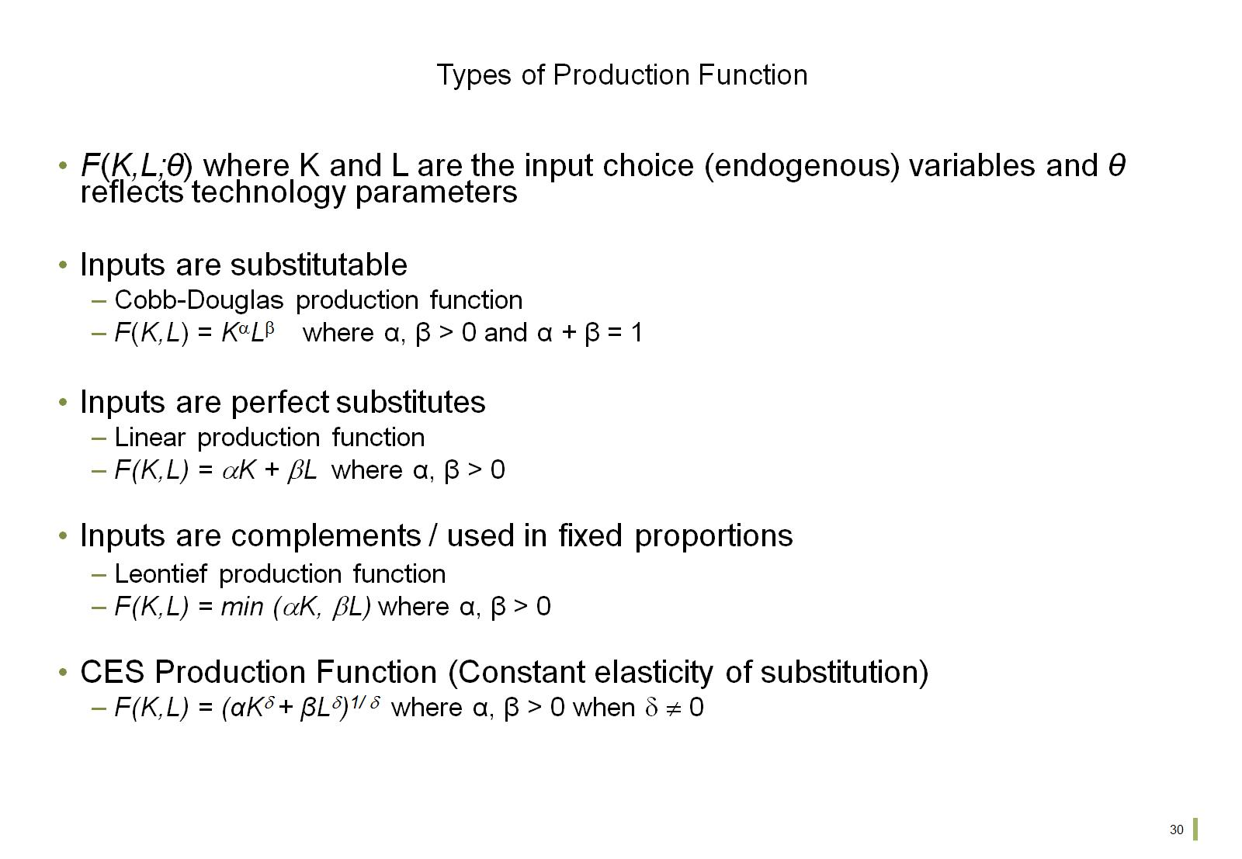
Types of Production Function

Slide 32
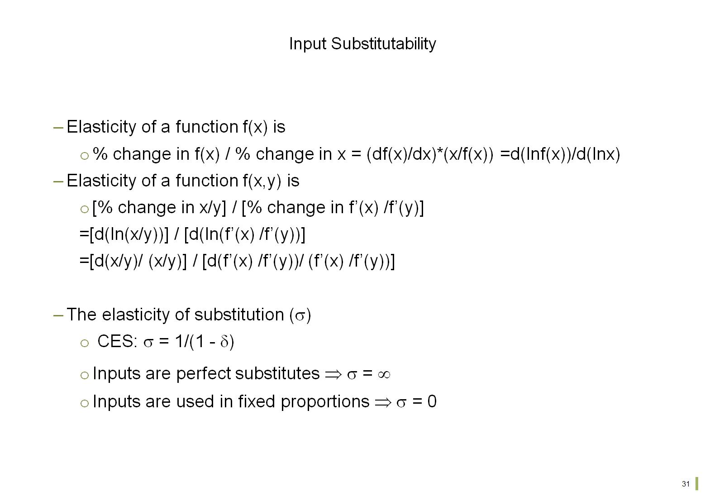
Input Substitutability

Slide 33
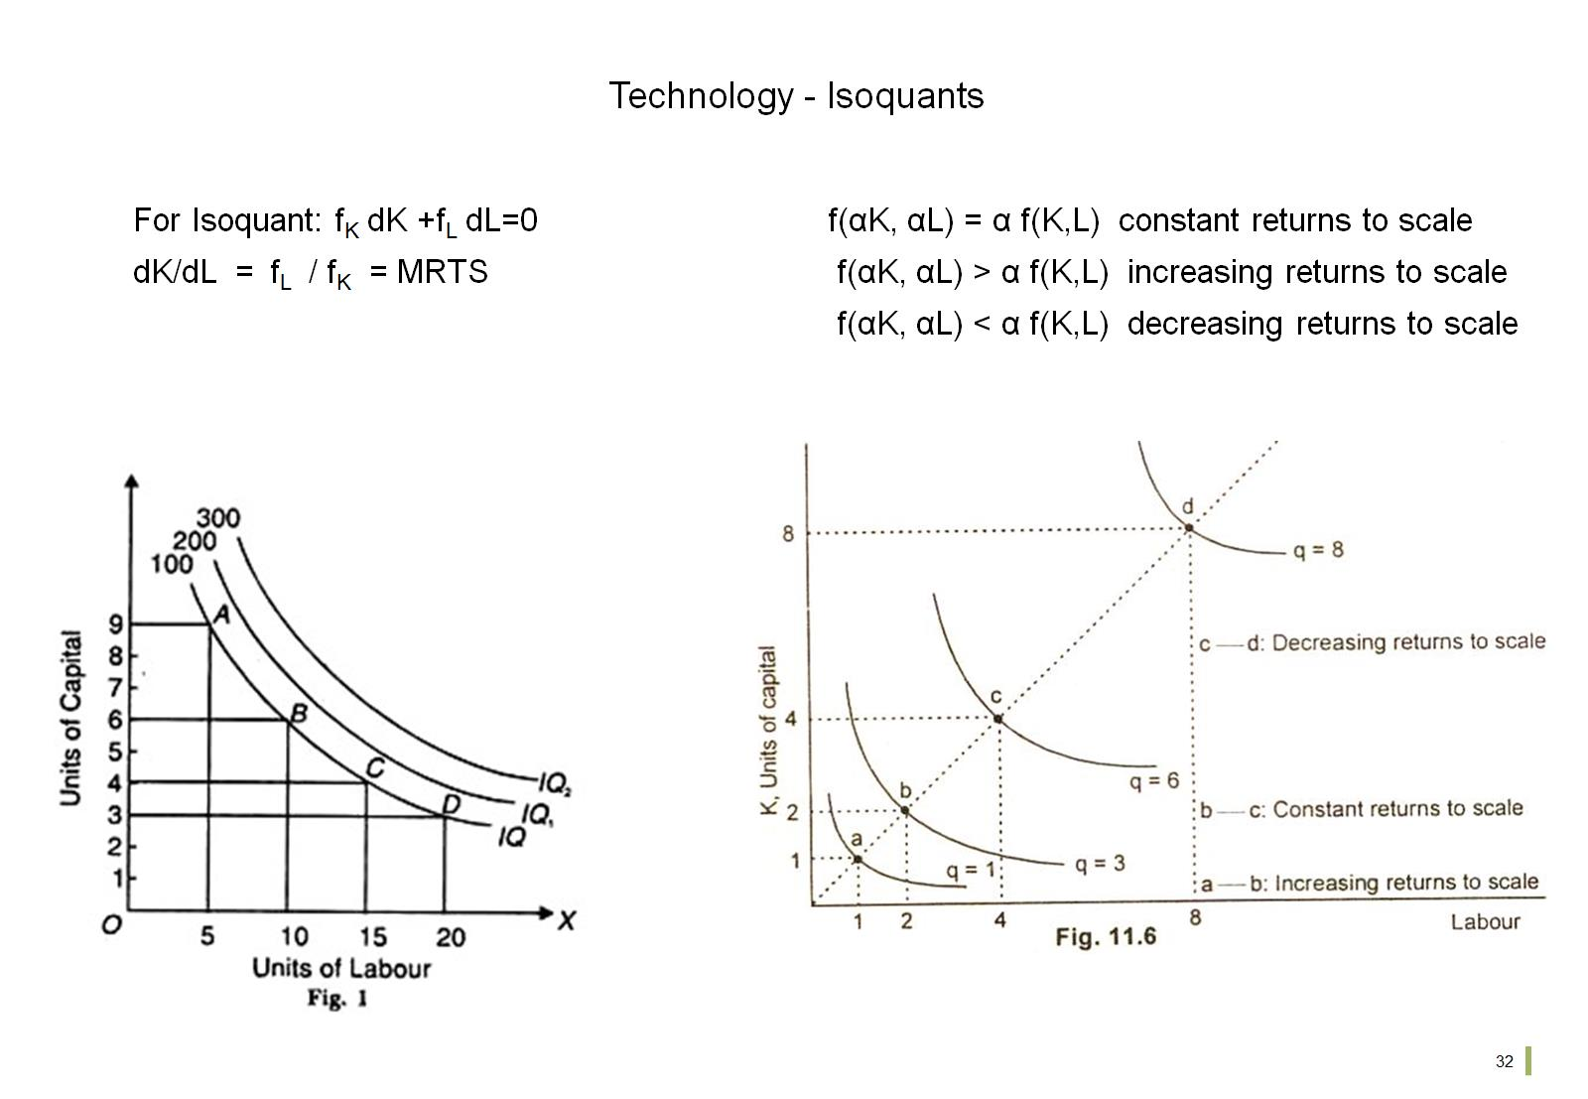
Technology - Isoquants

Slide 34
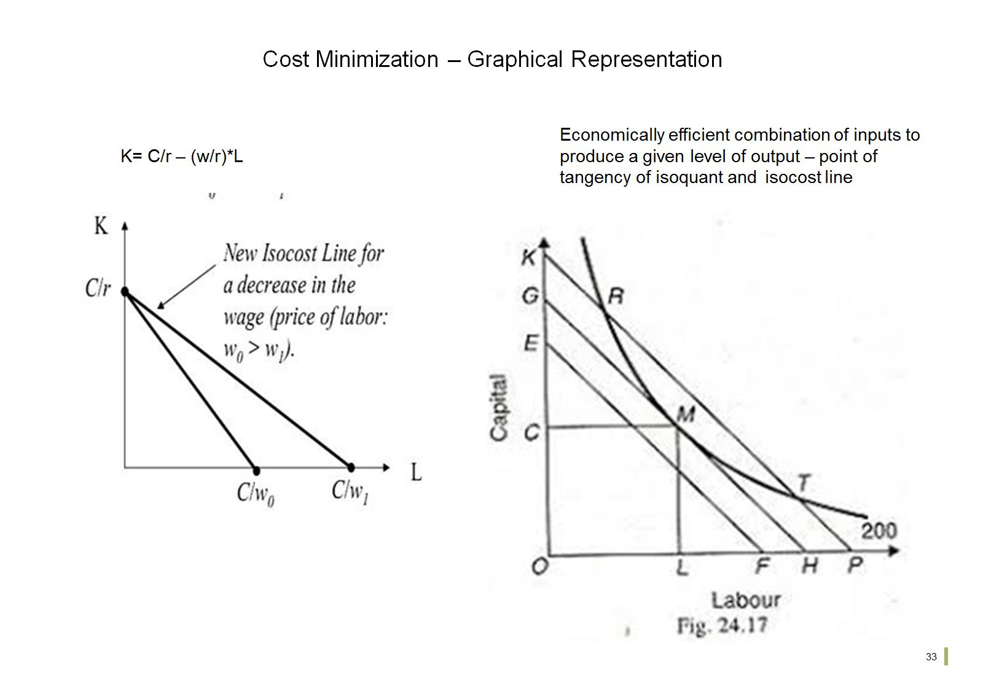
Cost Minimization – Graphical Representation

Slide 35
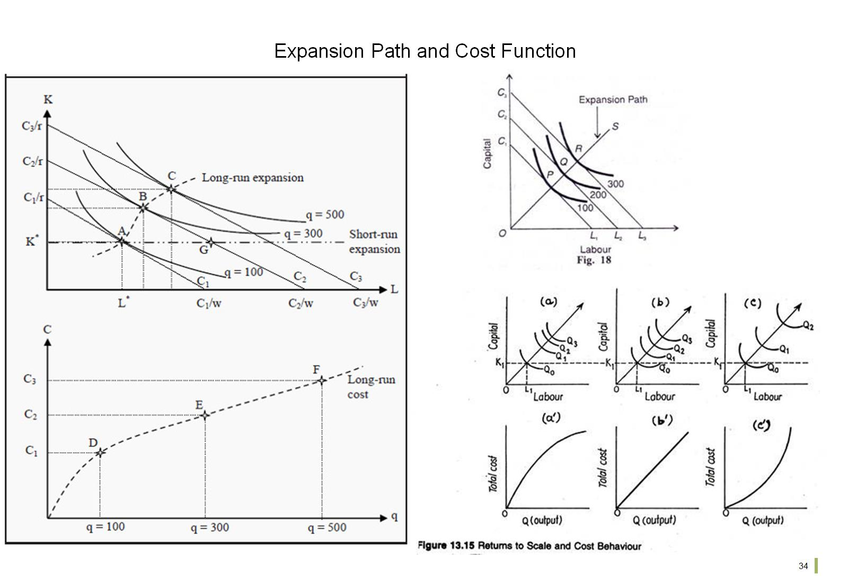
Expansion Path and Cost Function

Slide 36
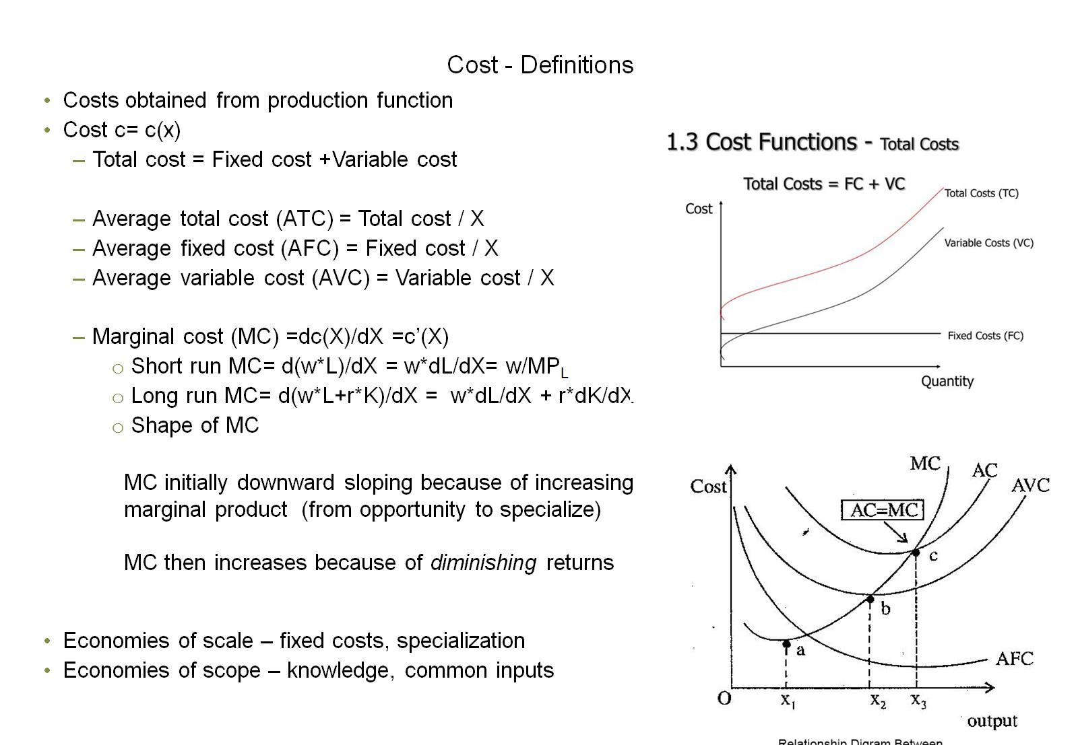
Cost - Definitions

Slide 37
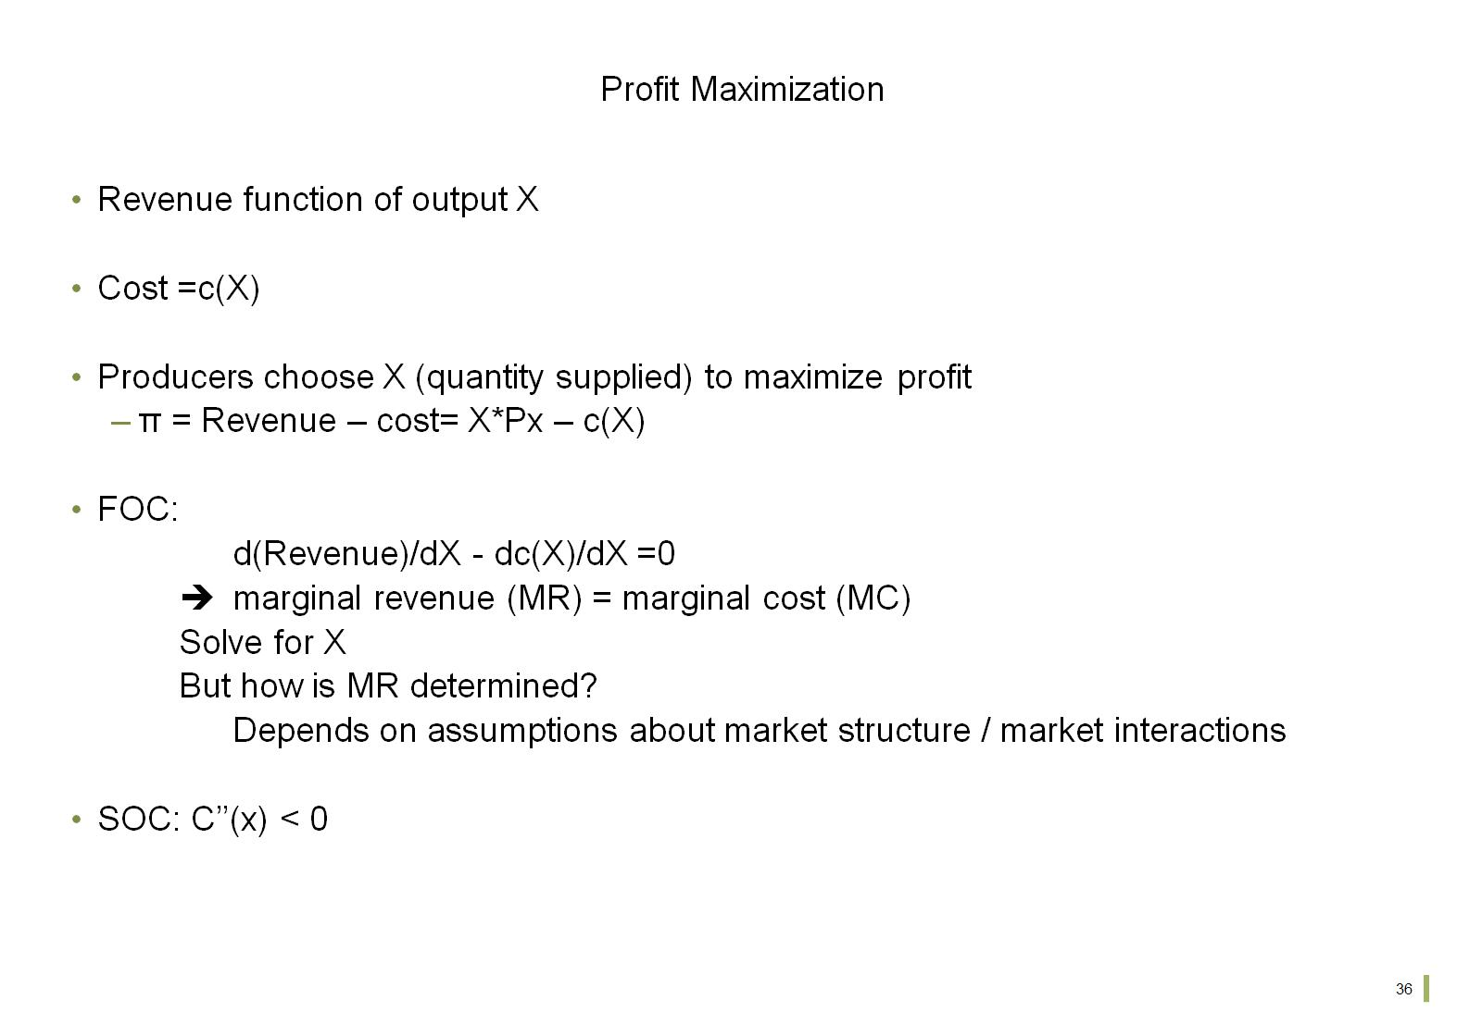
Profit Maximization

Slide 38
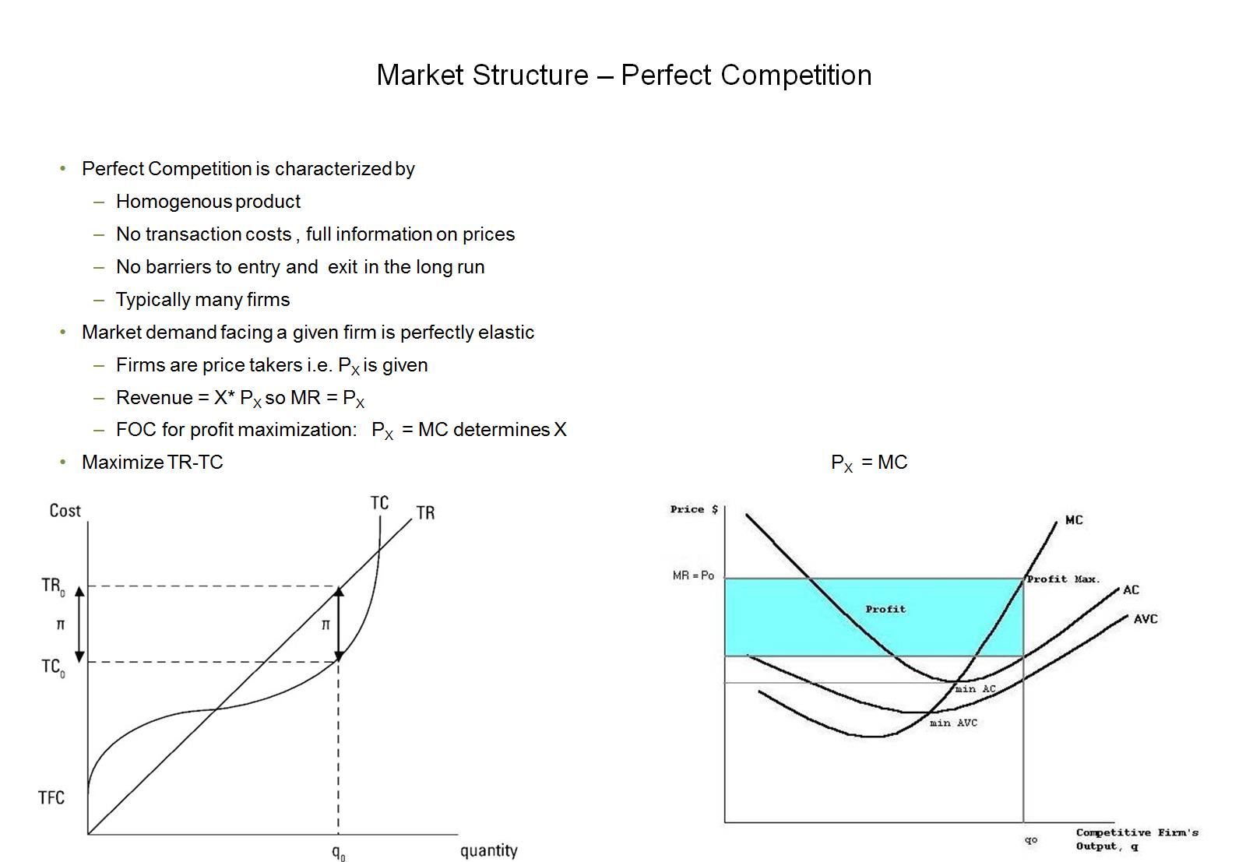
Market Structure – Perfect Competition

Slide 39
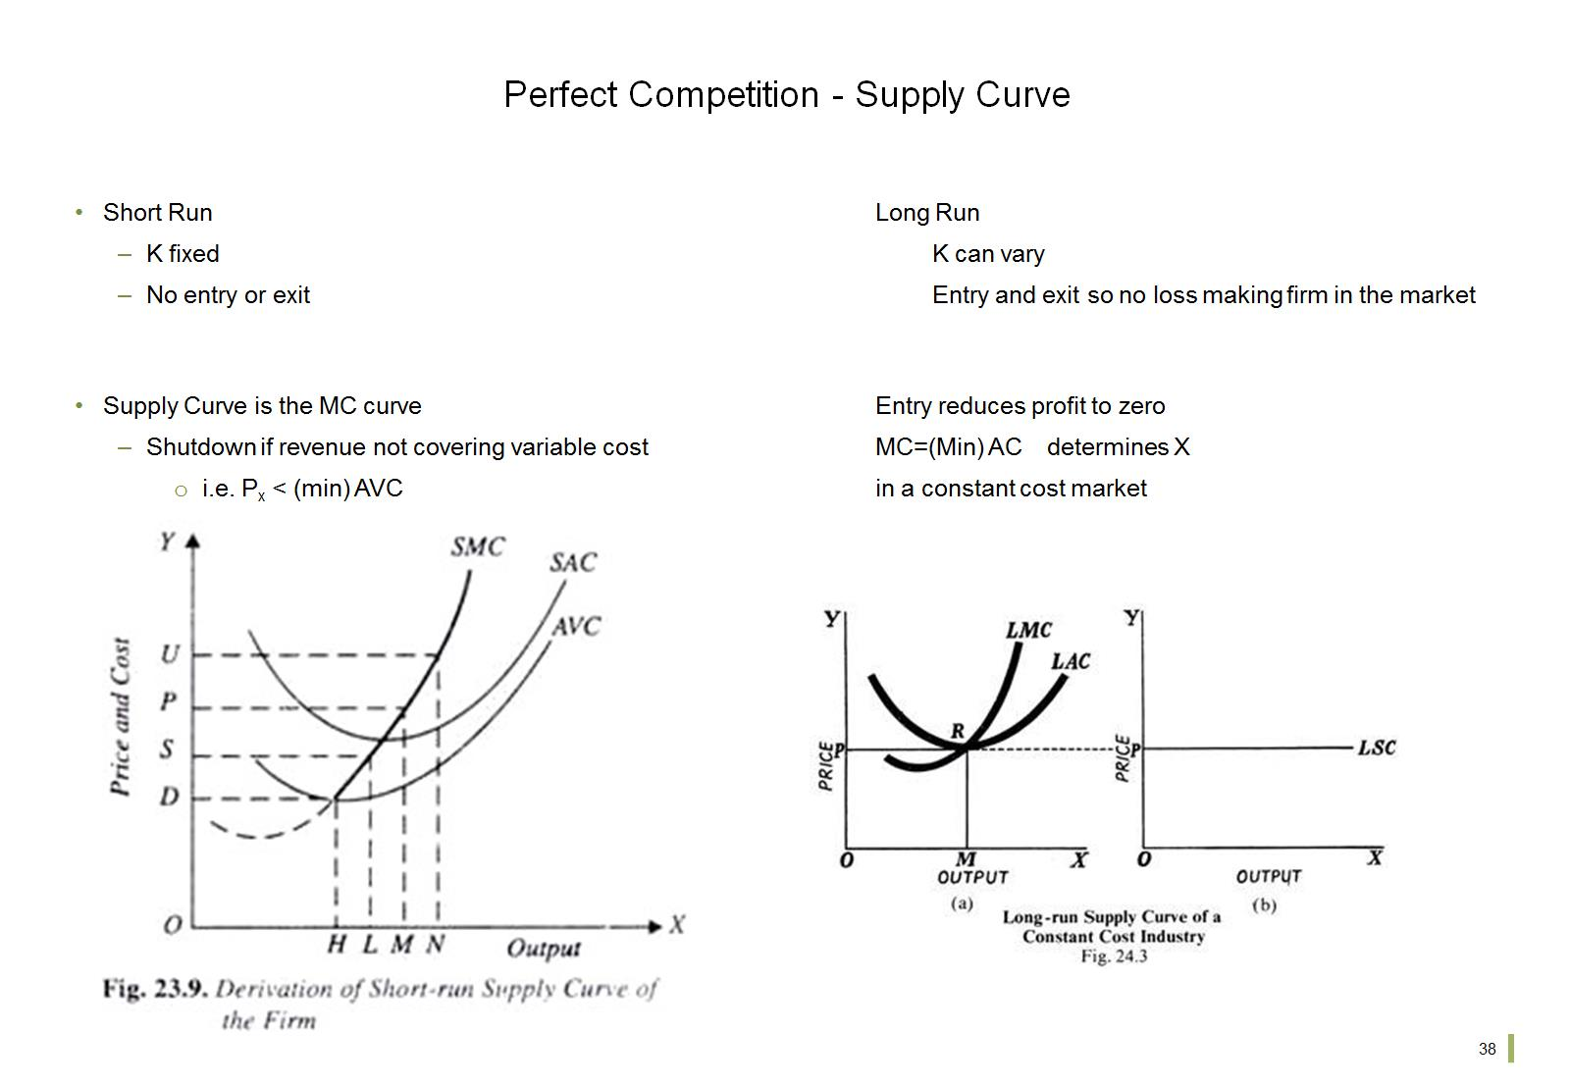
Perfect Competition - Supply Curve

Slide 40
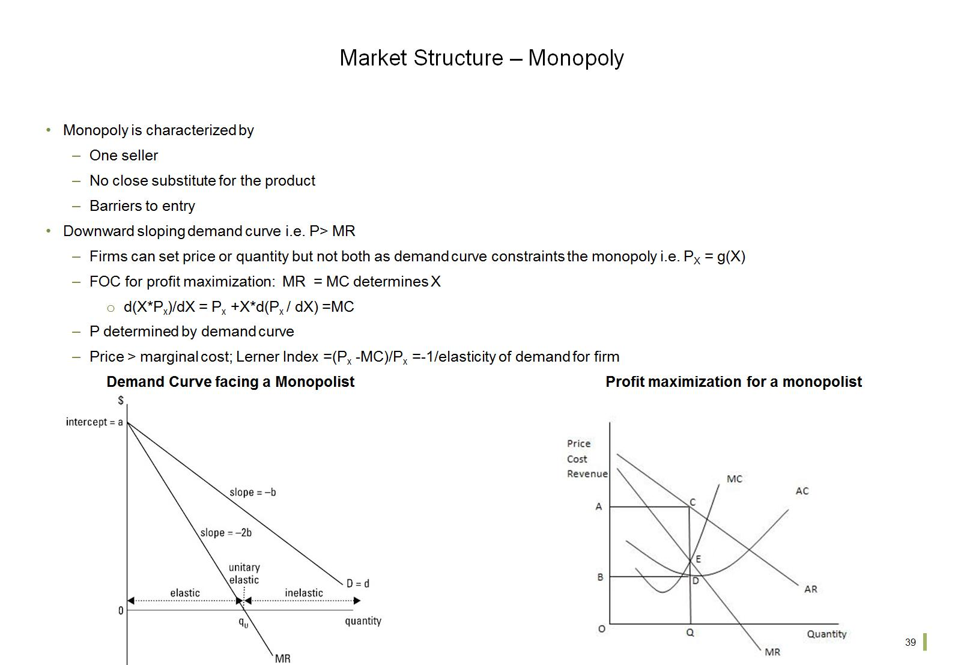
Market Structure – Monopoly

Slide 41
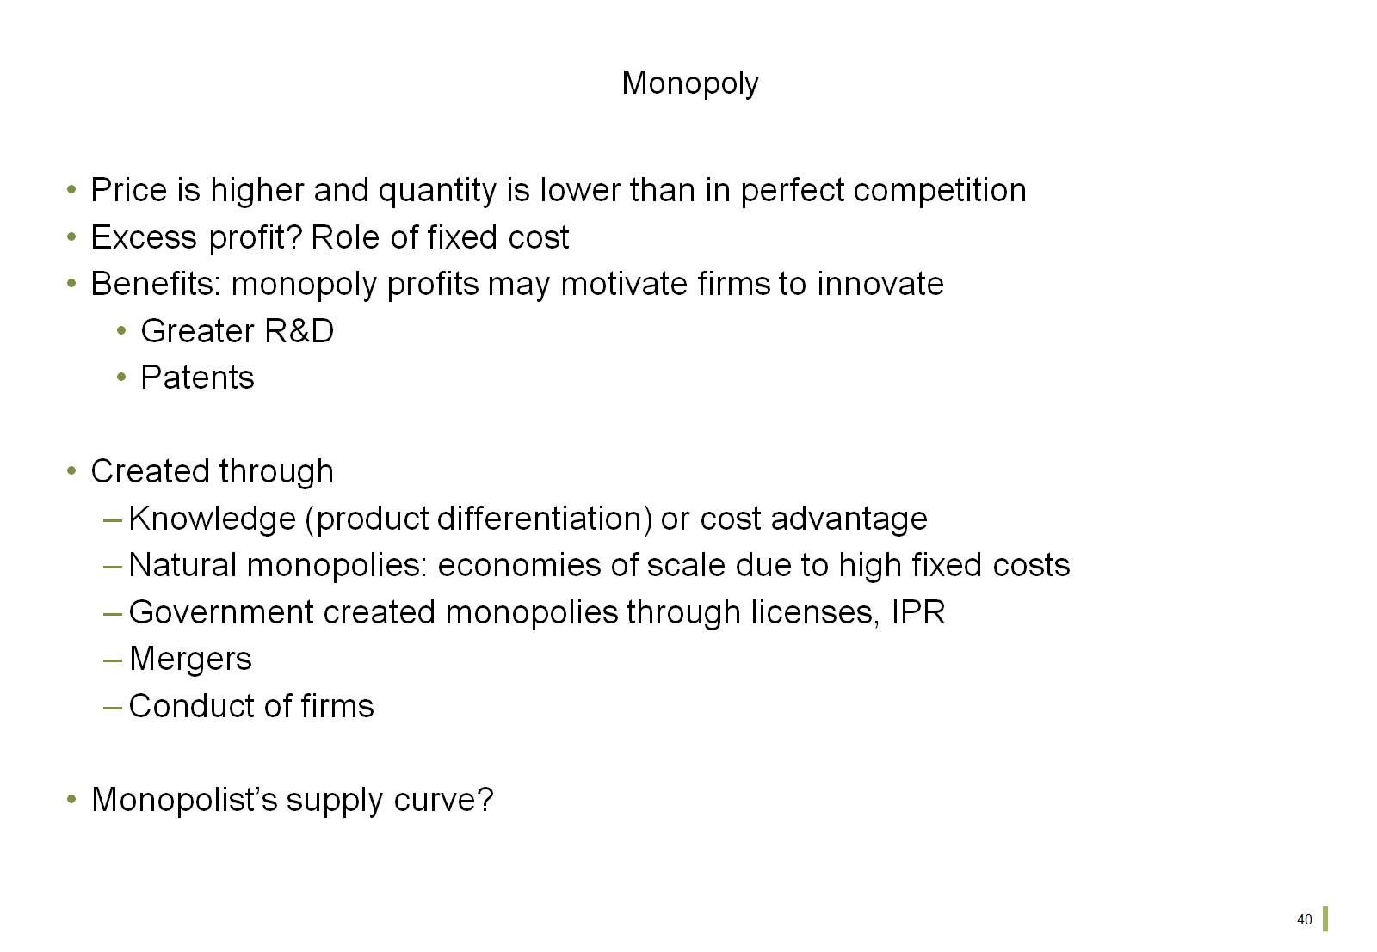
Monopoly

Slide 42
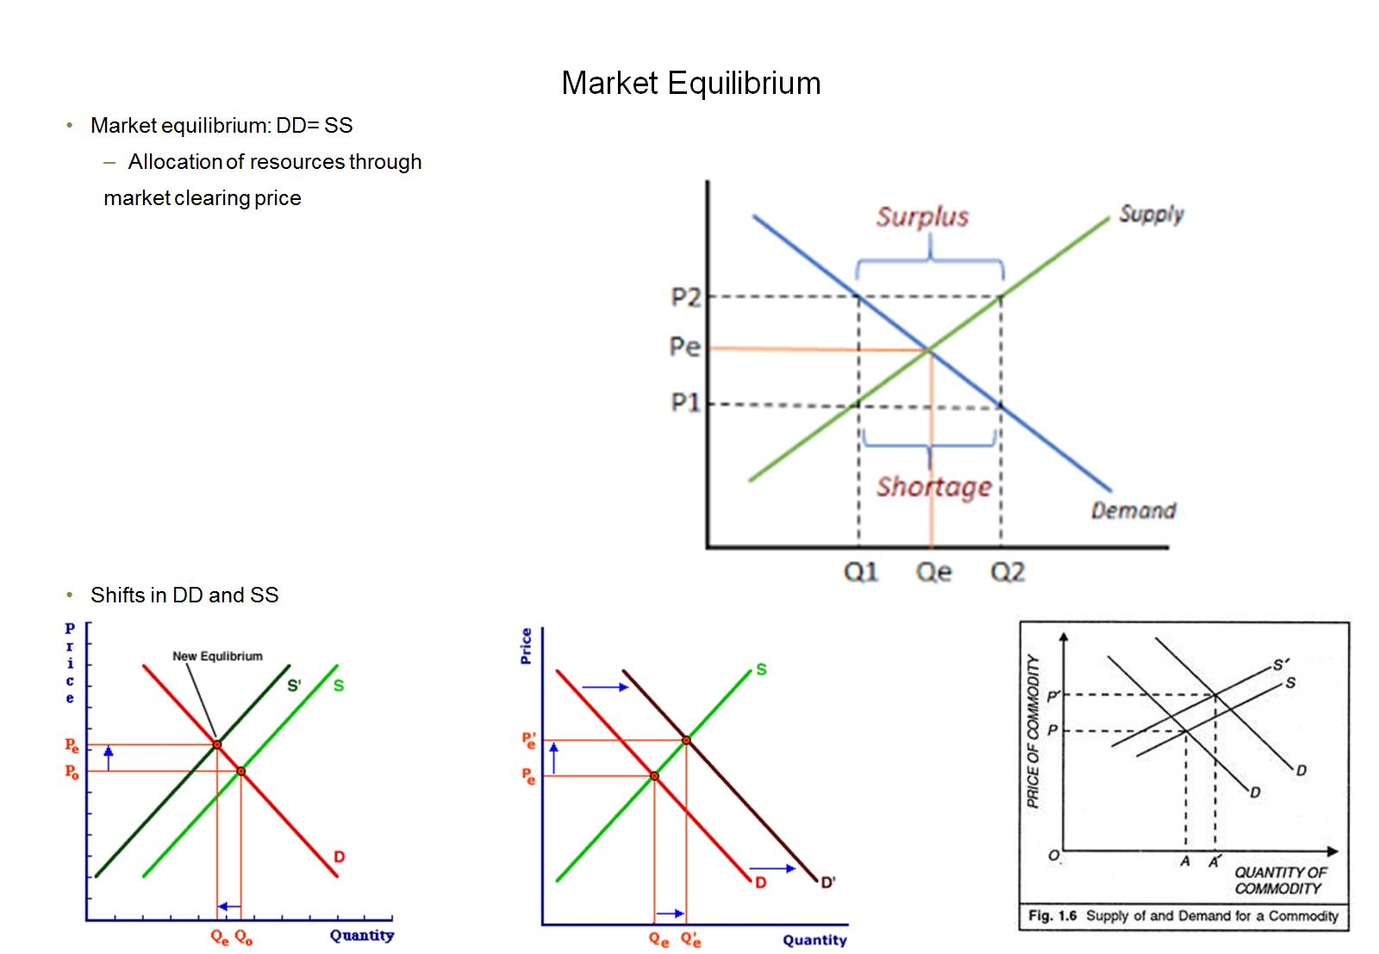
Market Equilibrium

Slide 43
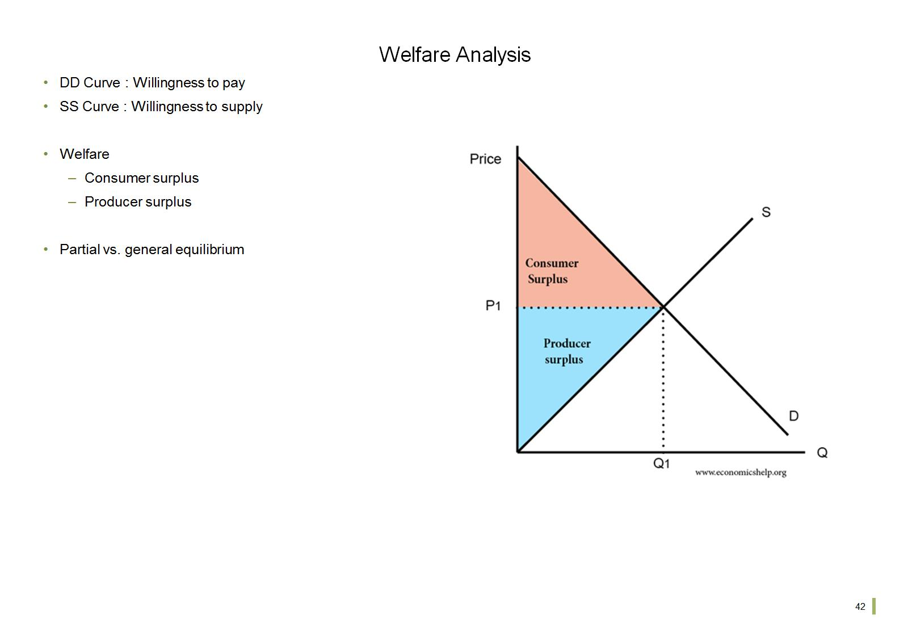
Welfare Analysis

Slide 44
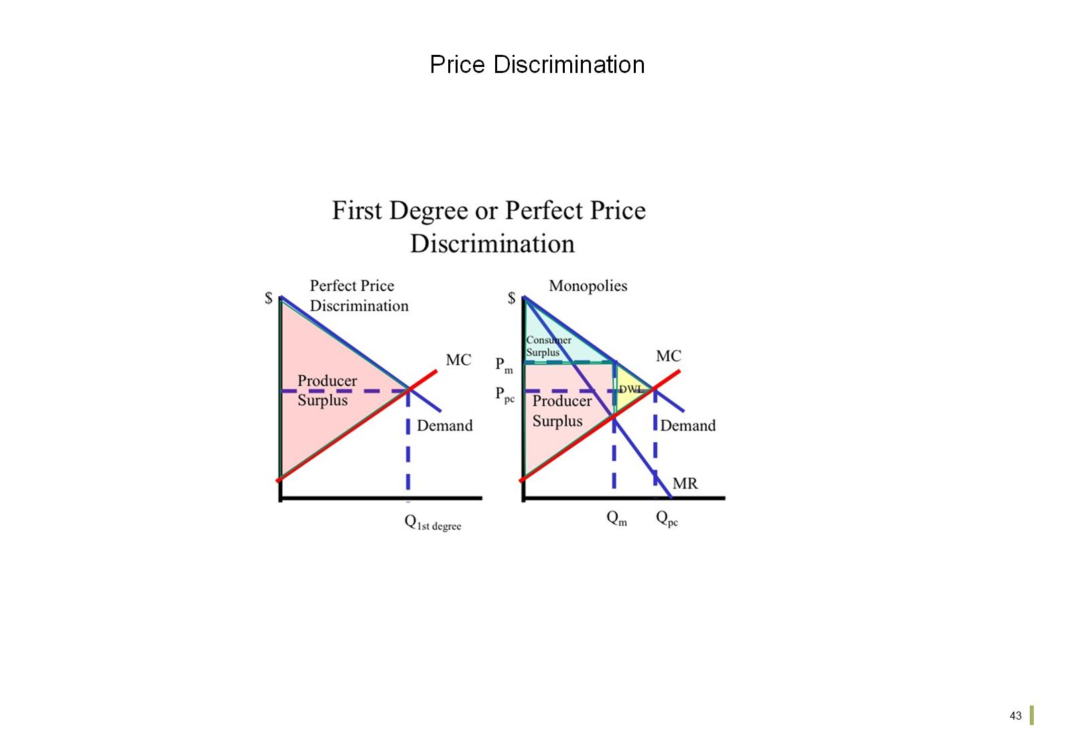
Price Discrimination

Slide 45
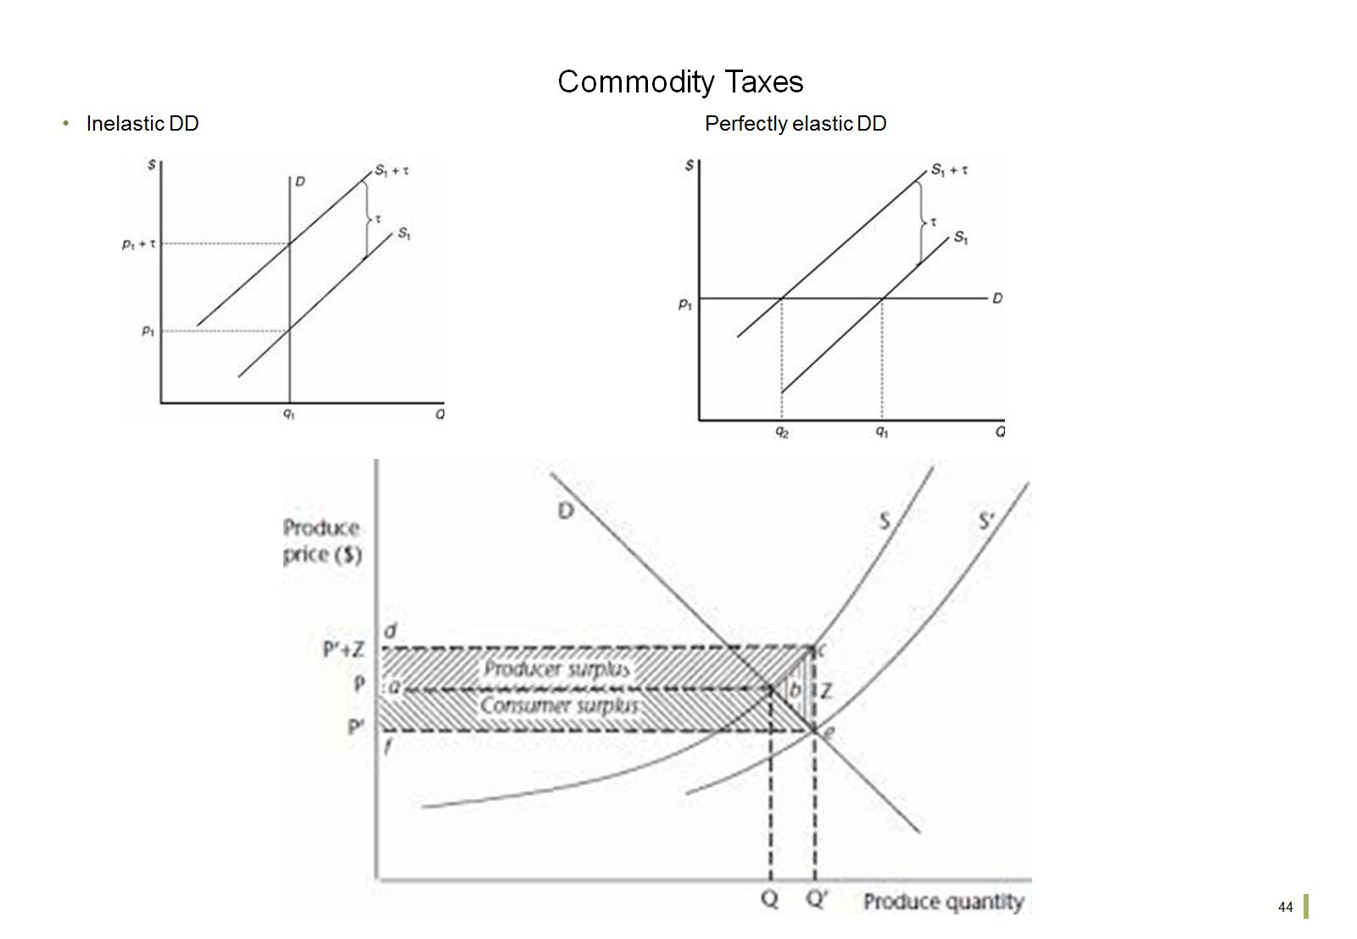
Commodity Taxes

Slide 46
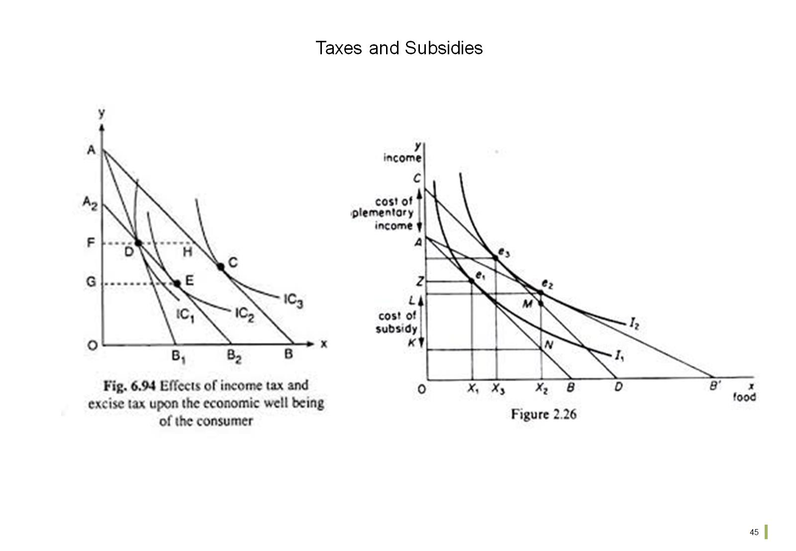
Taxes and Subsidies

Slide 47
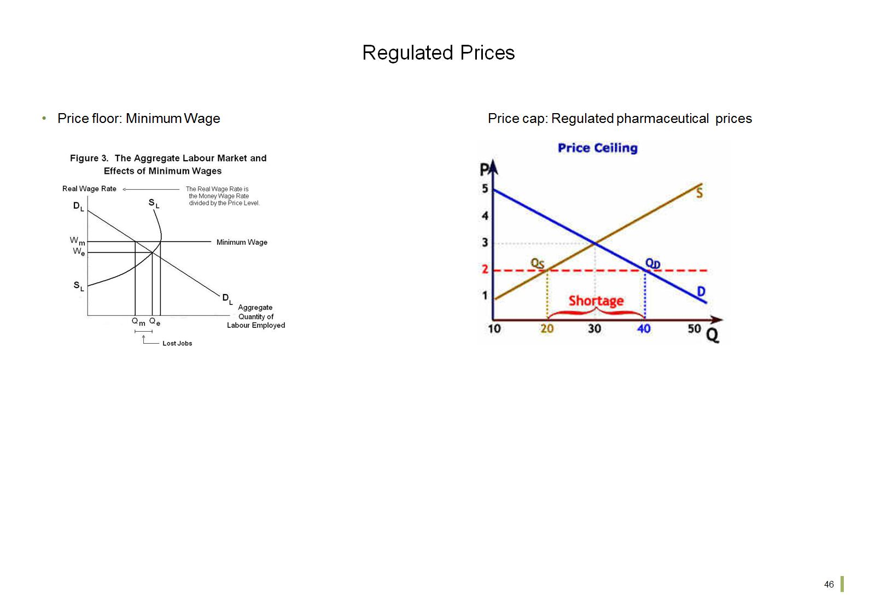
Regulated Prices

Slide 48
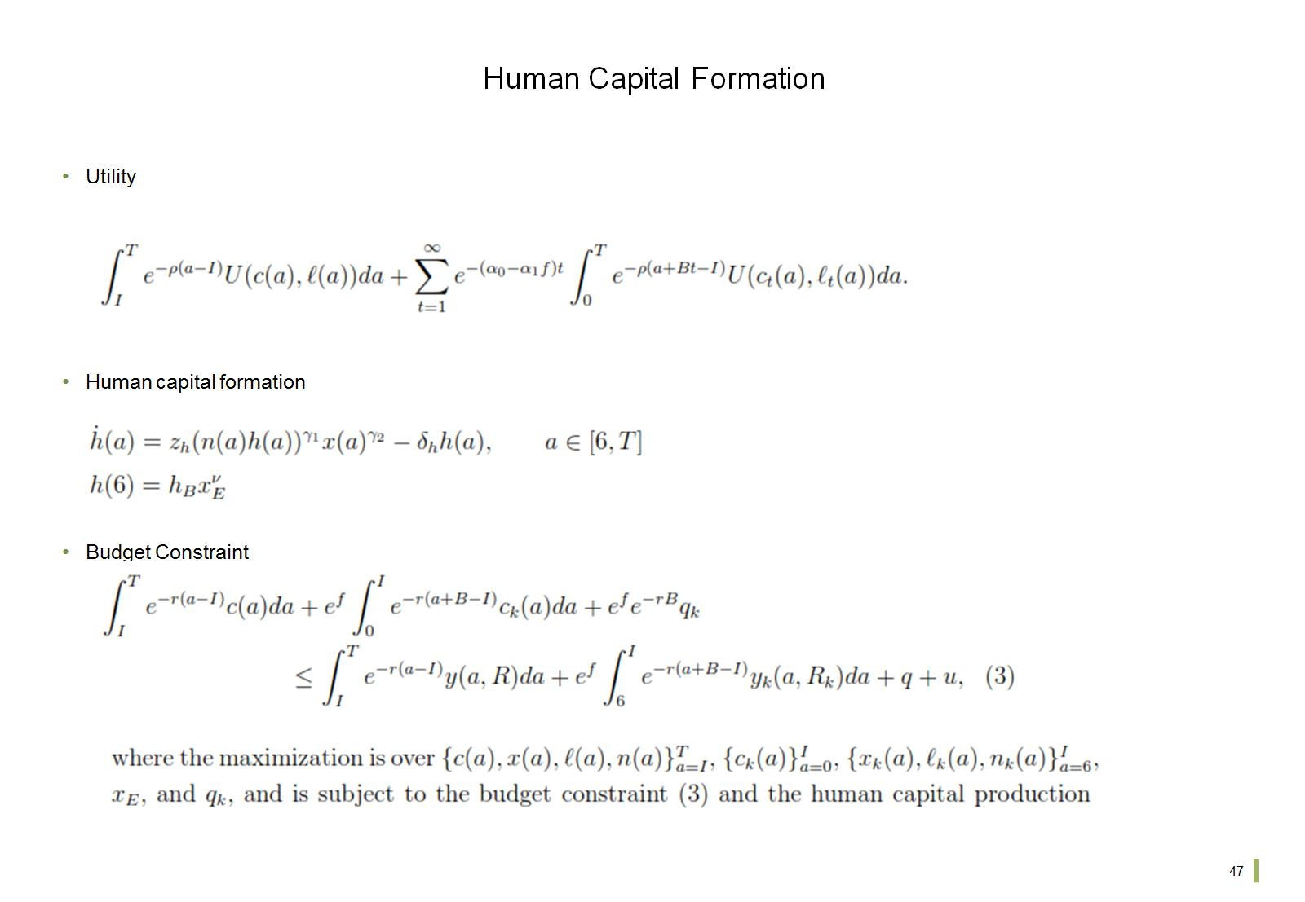
Human Capital Formation

